Slide 1
A22-A25
2h strip
2h anneal 500C
375C 40N 15min
Sub 1N fail

Slide 2
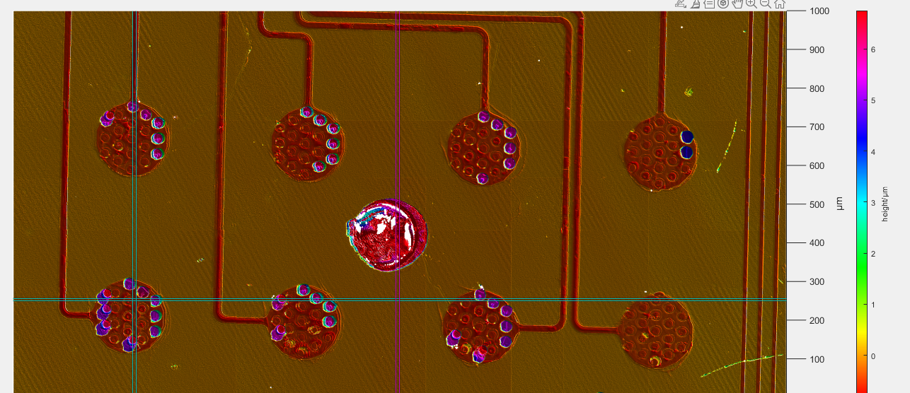
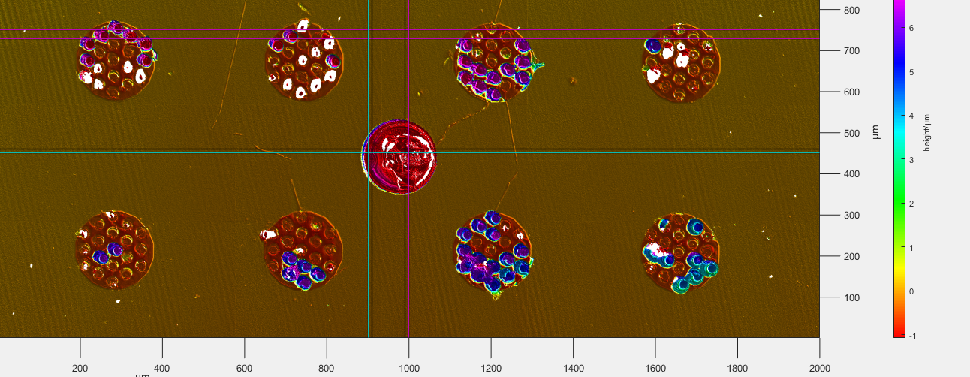
A22
Post Pull Test
Better alignment of Pads

Slide 3
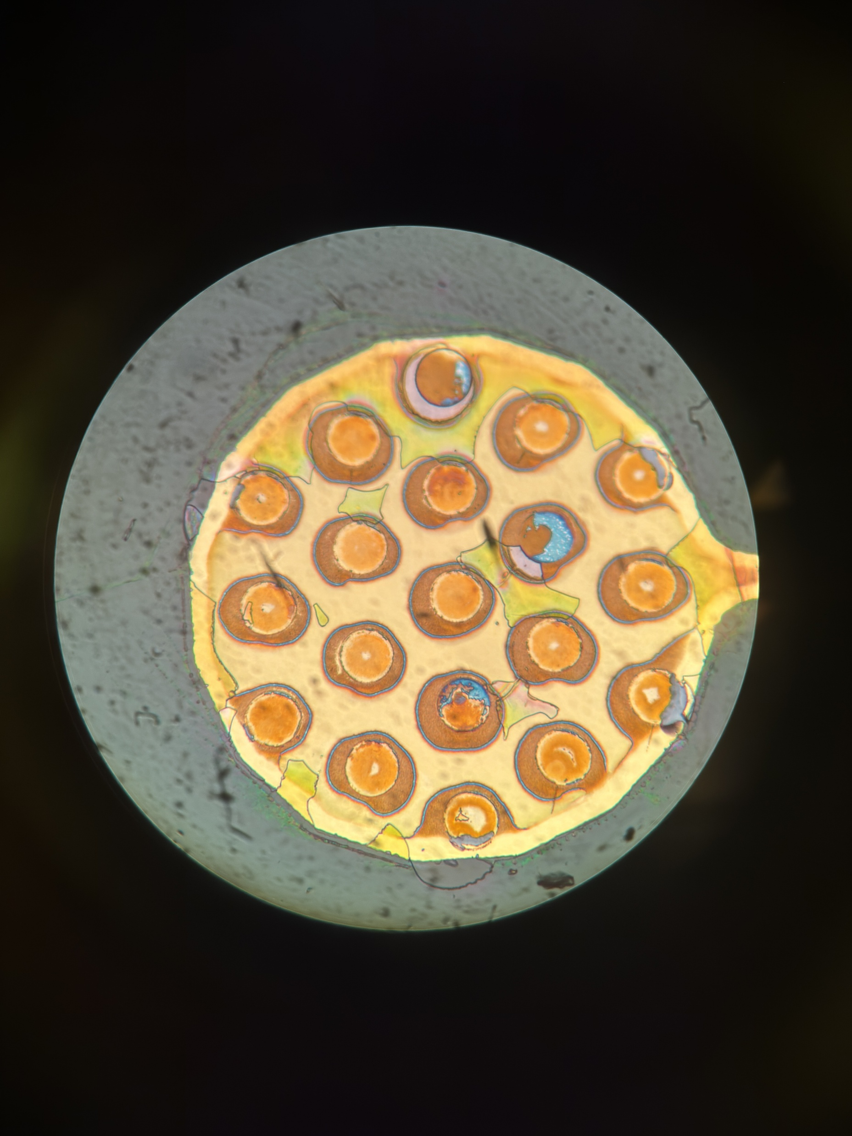
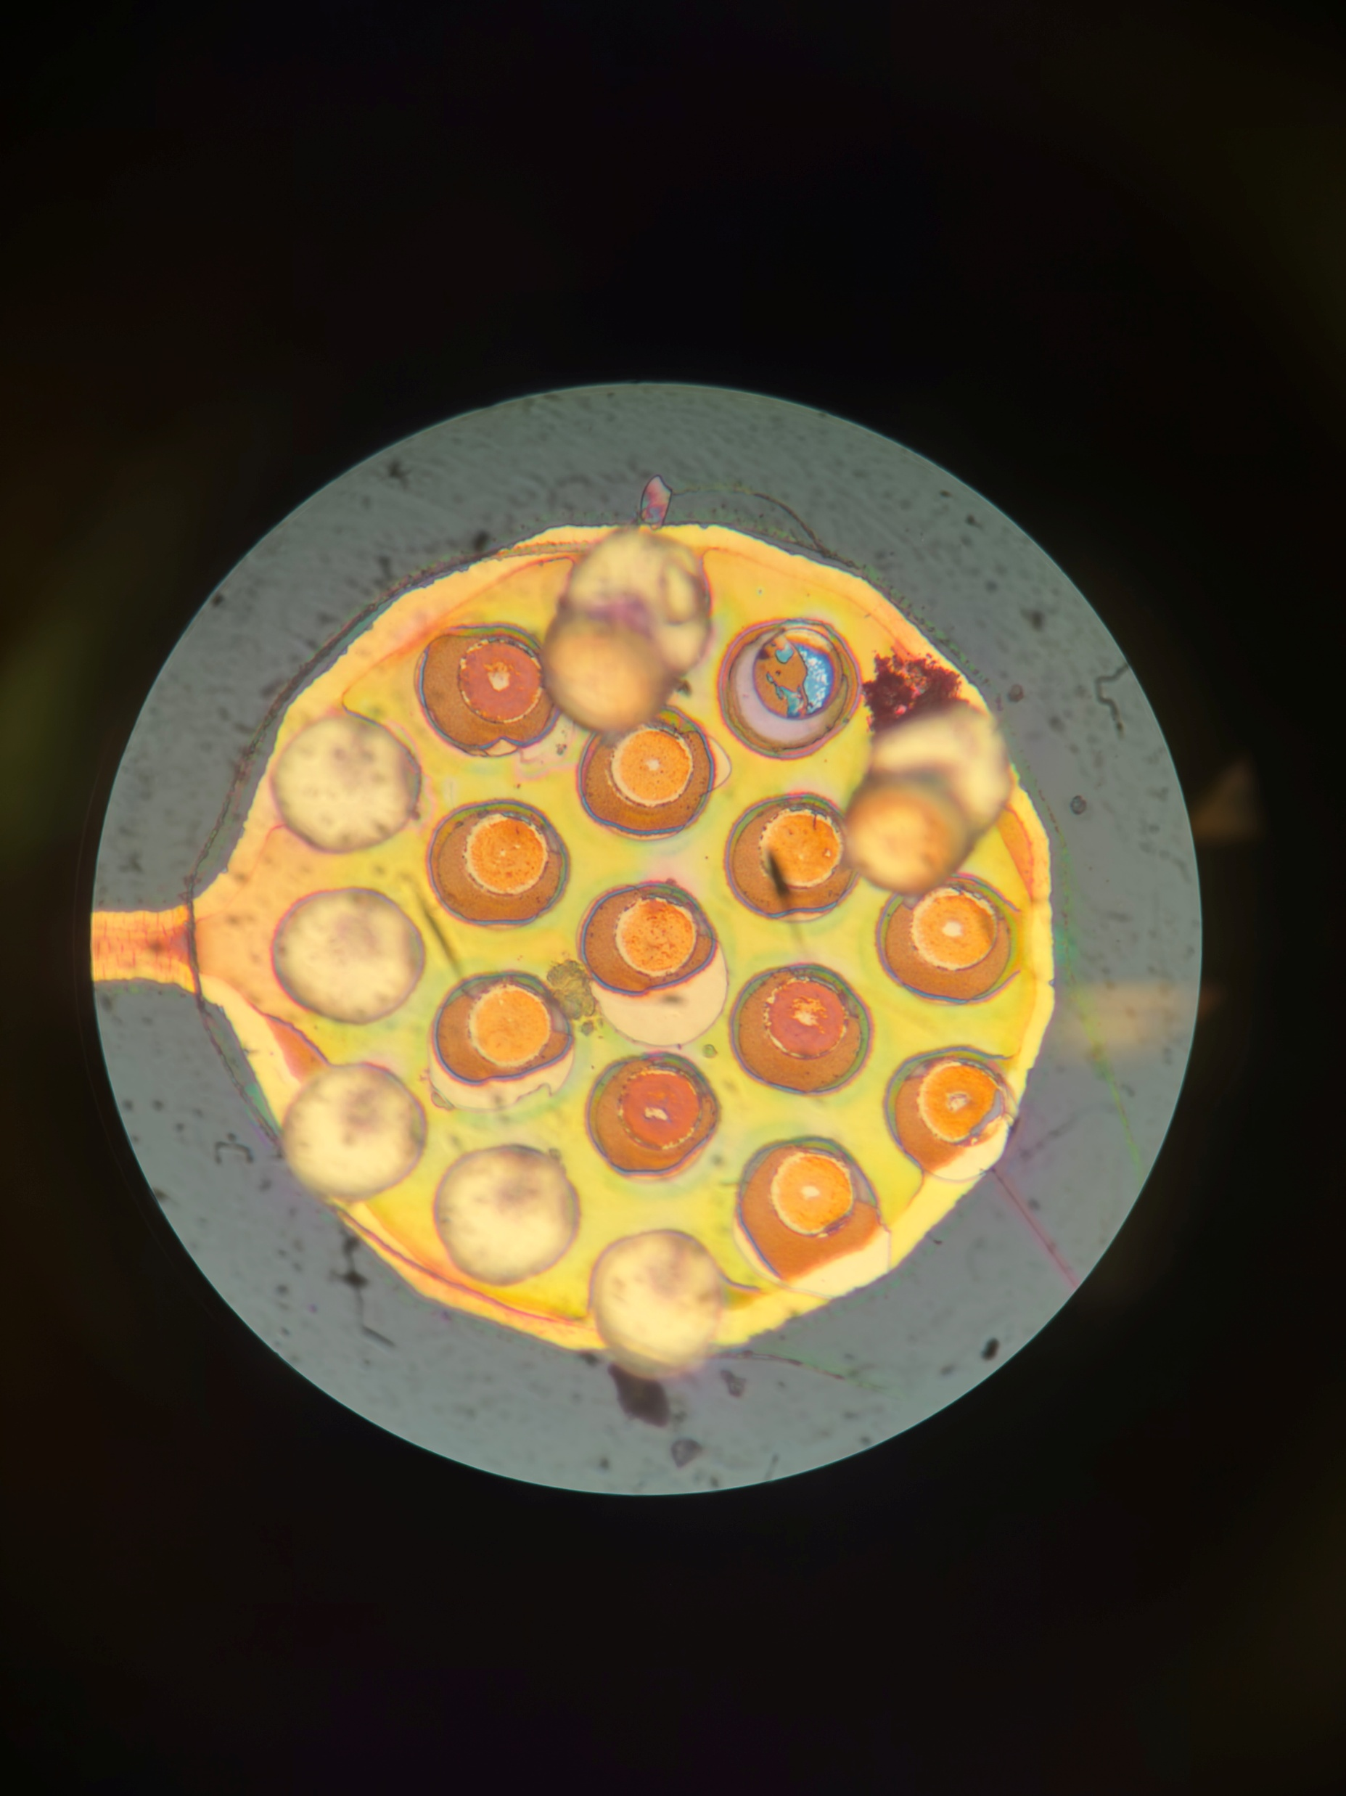
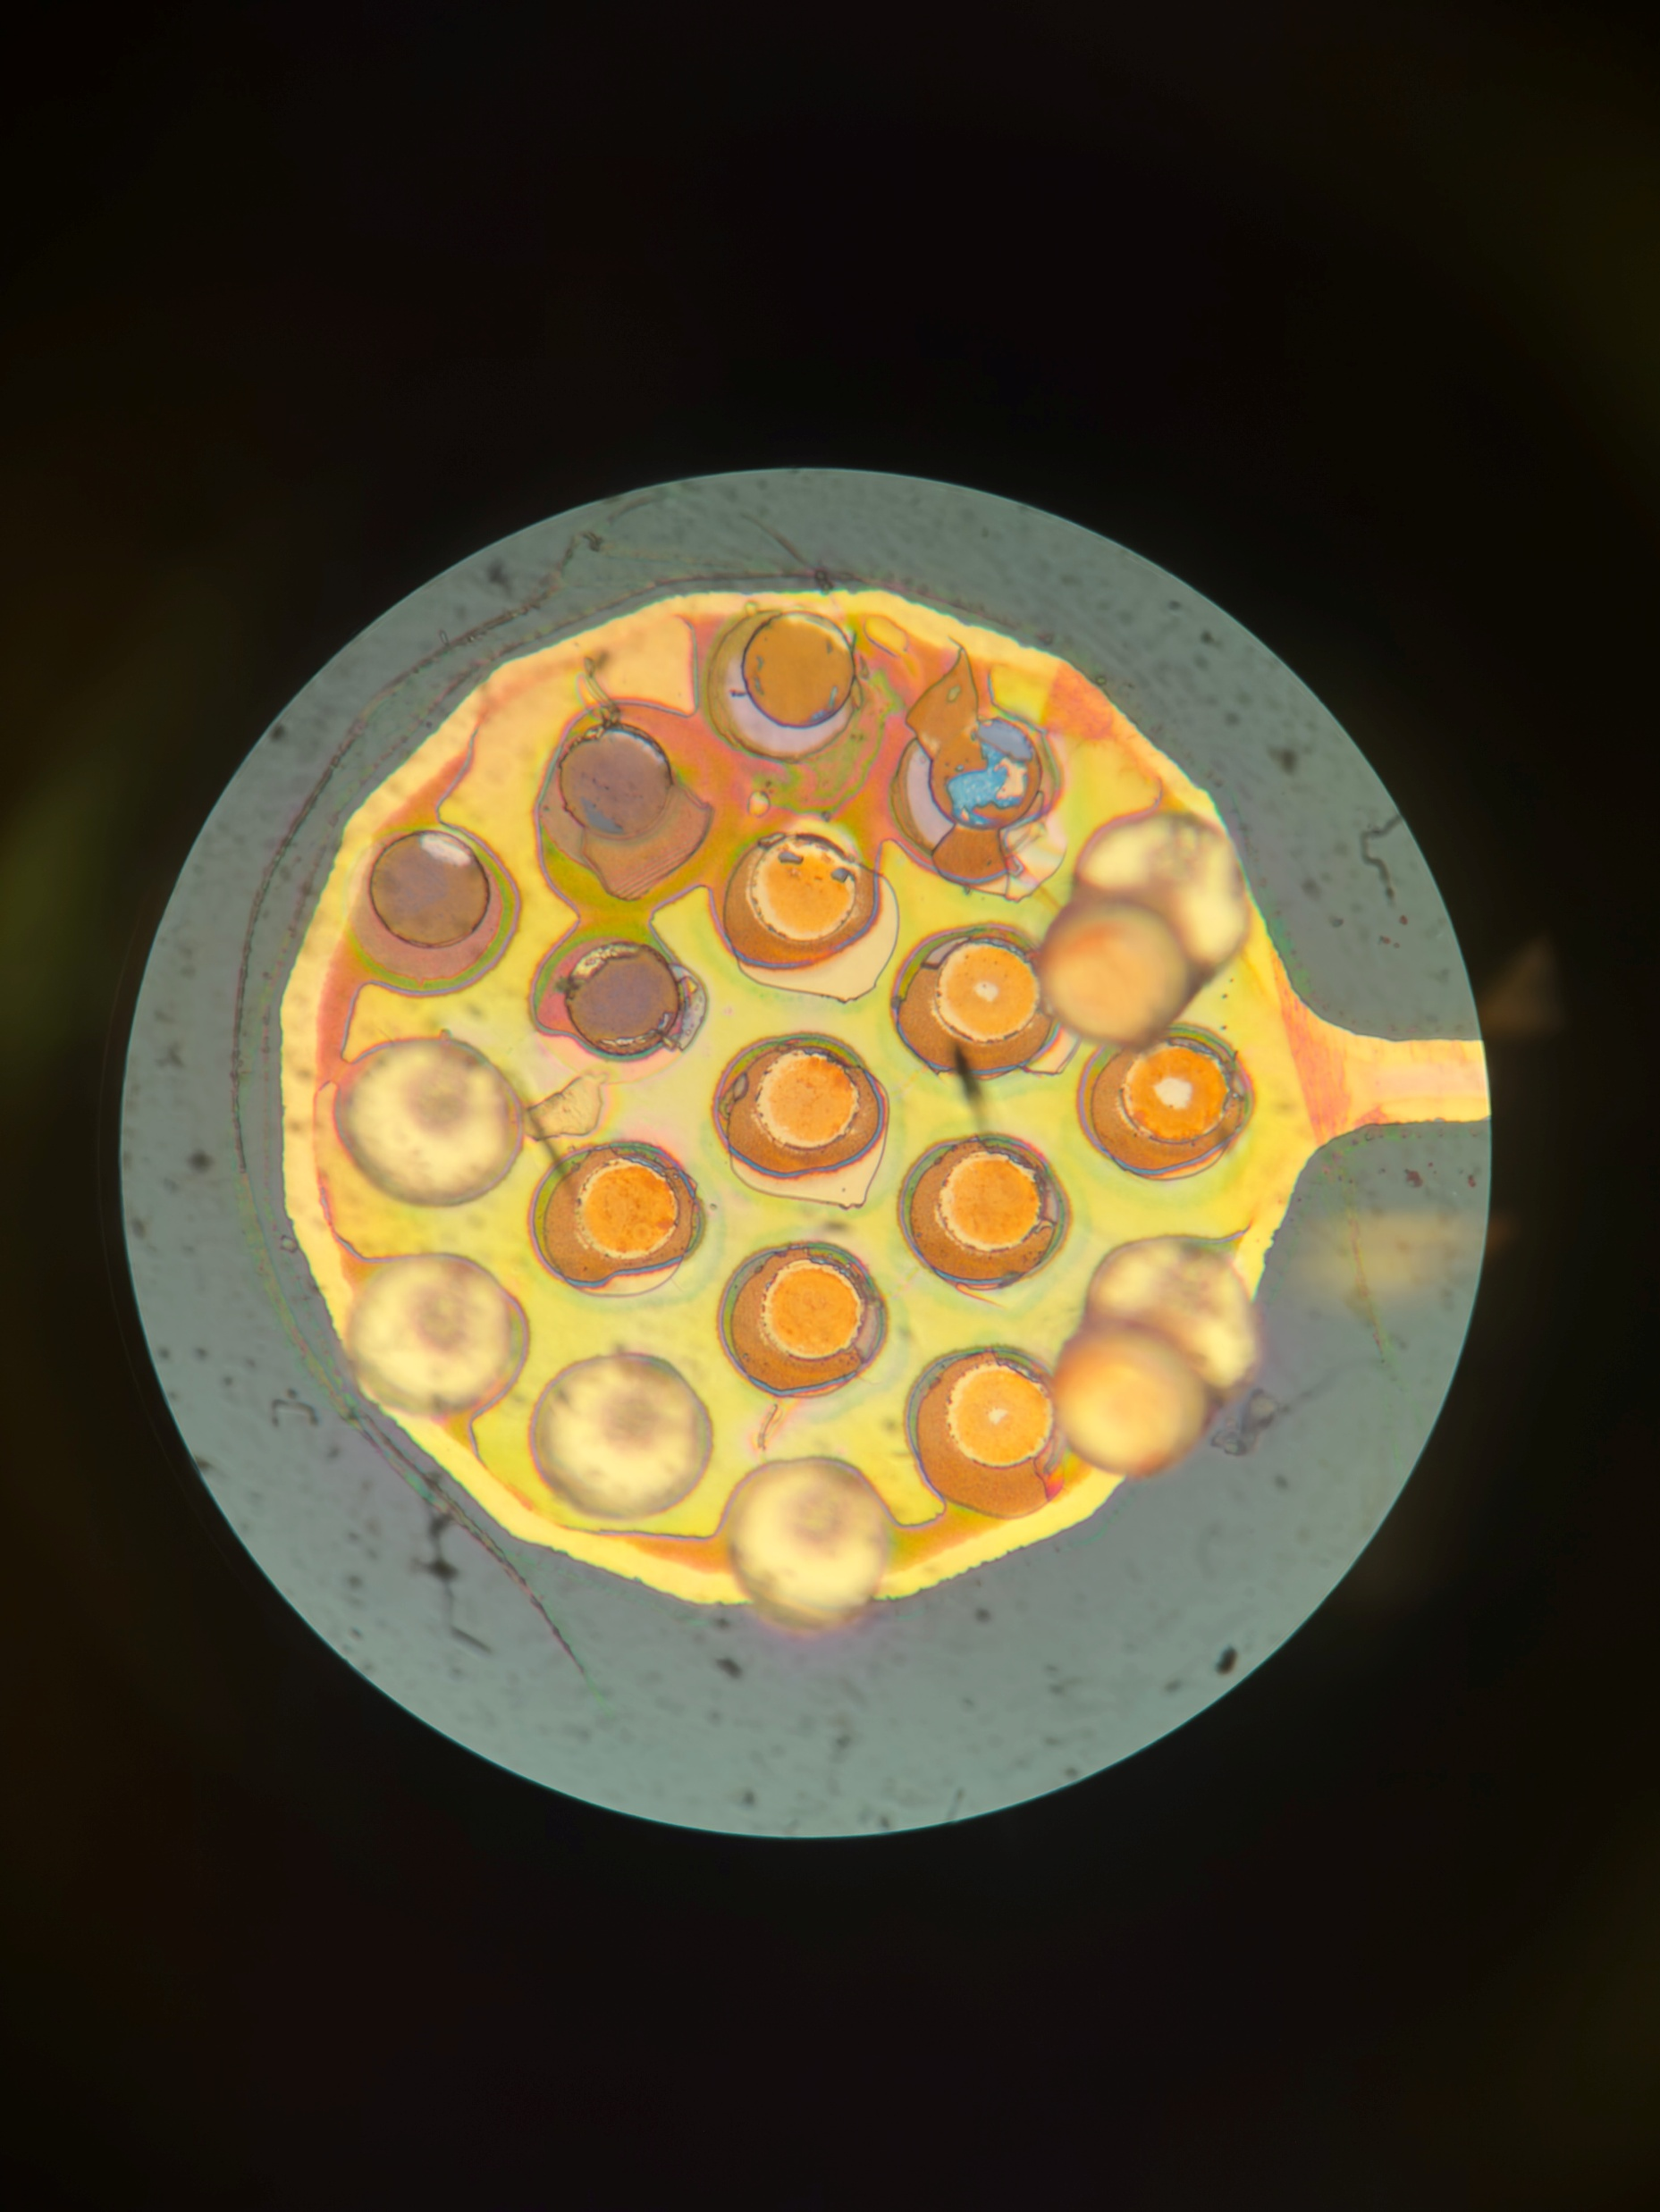
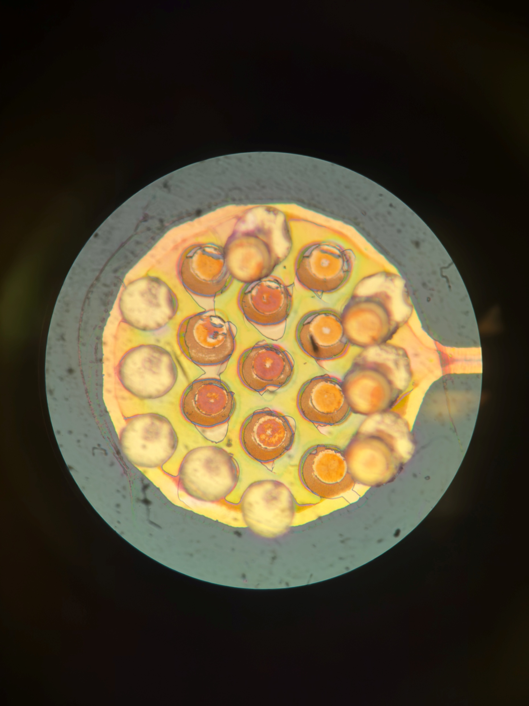
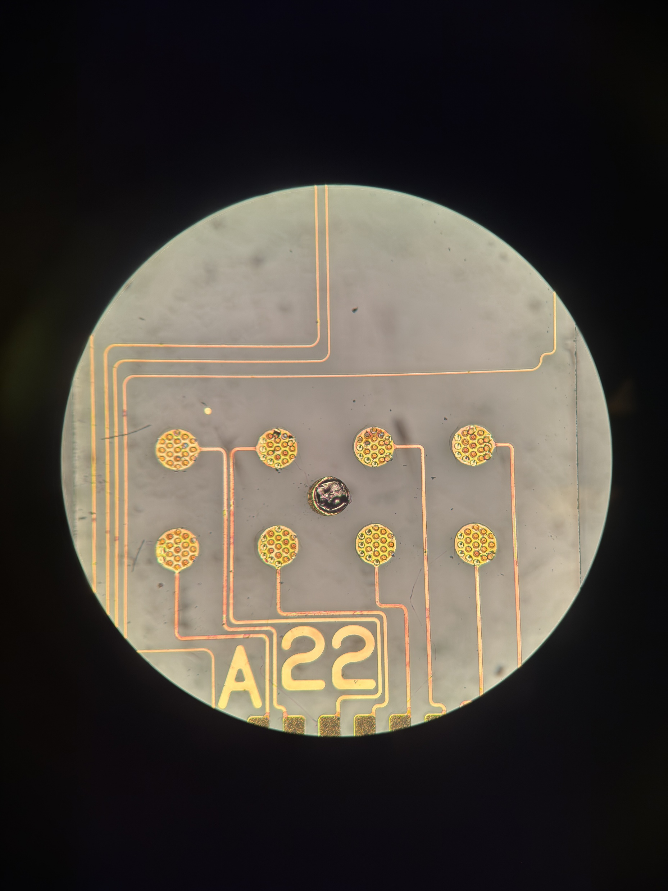
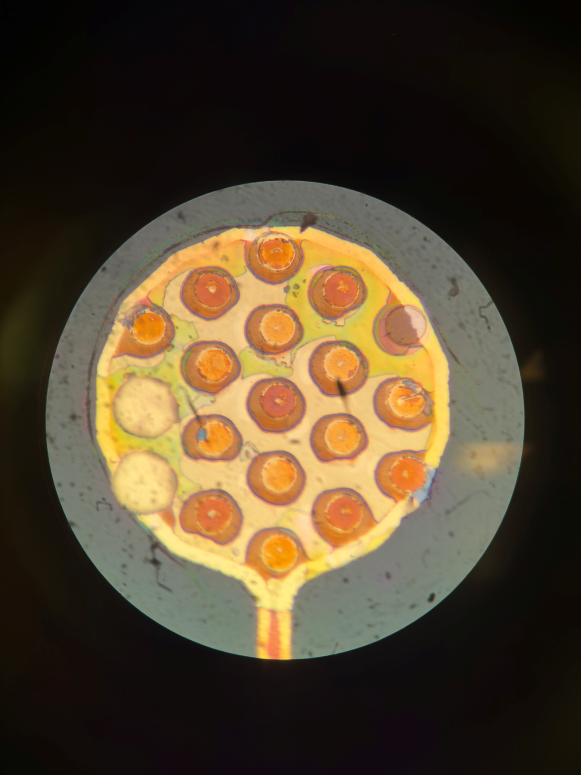
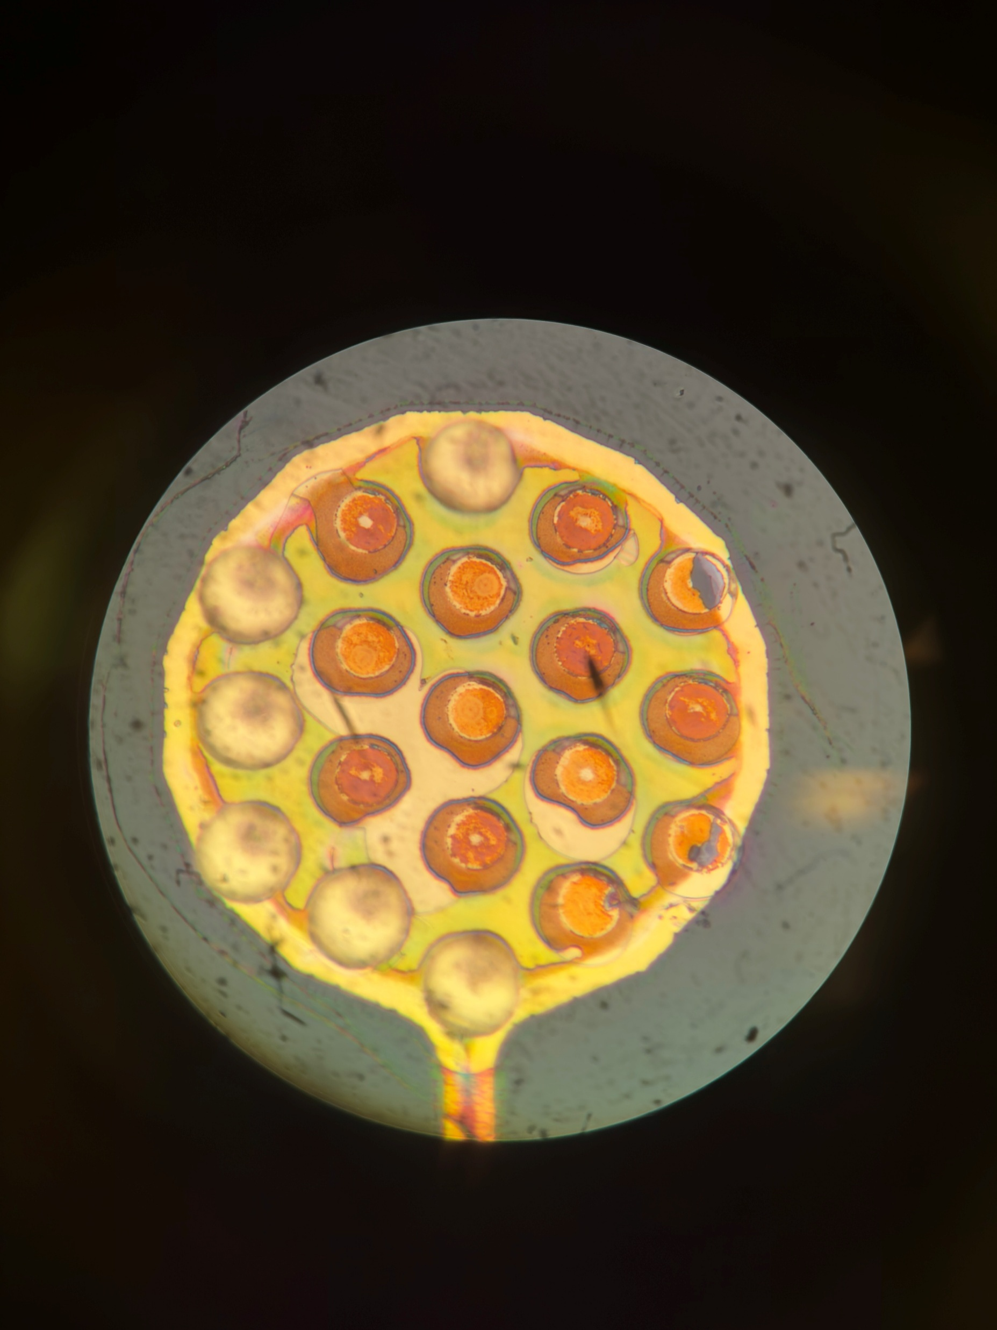
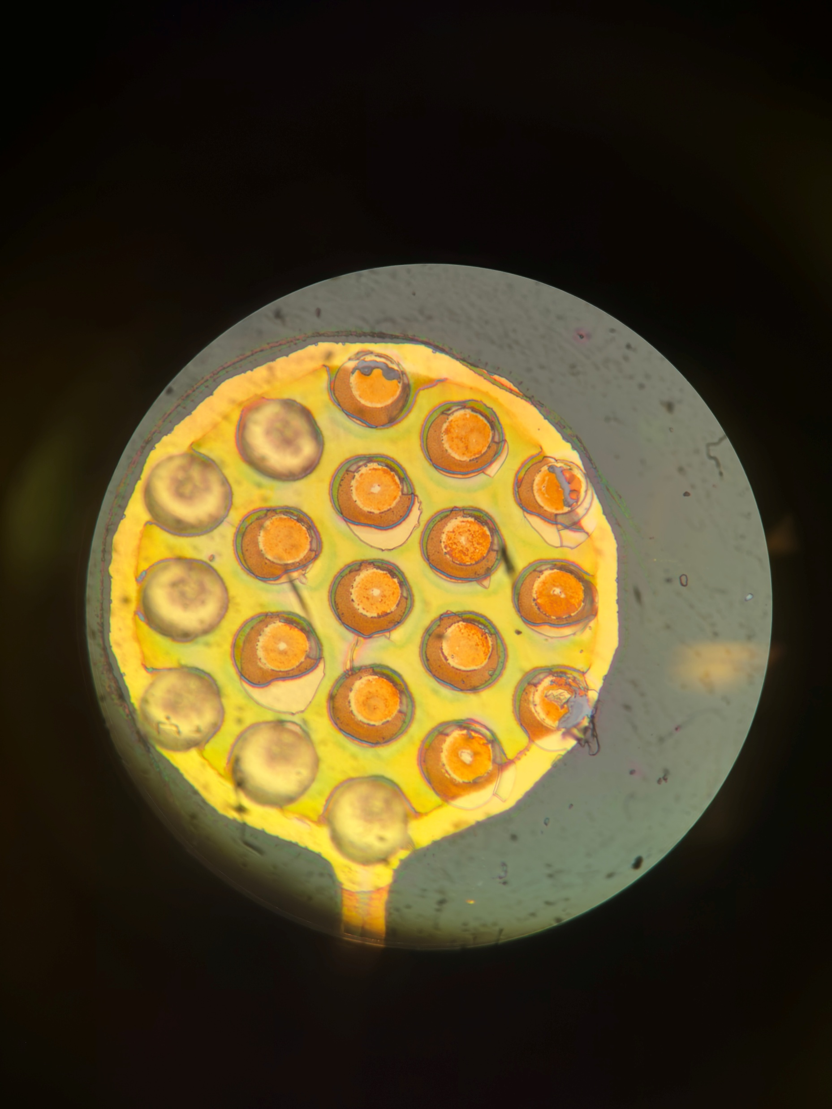
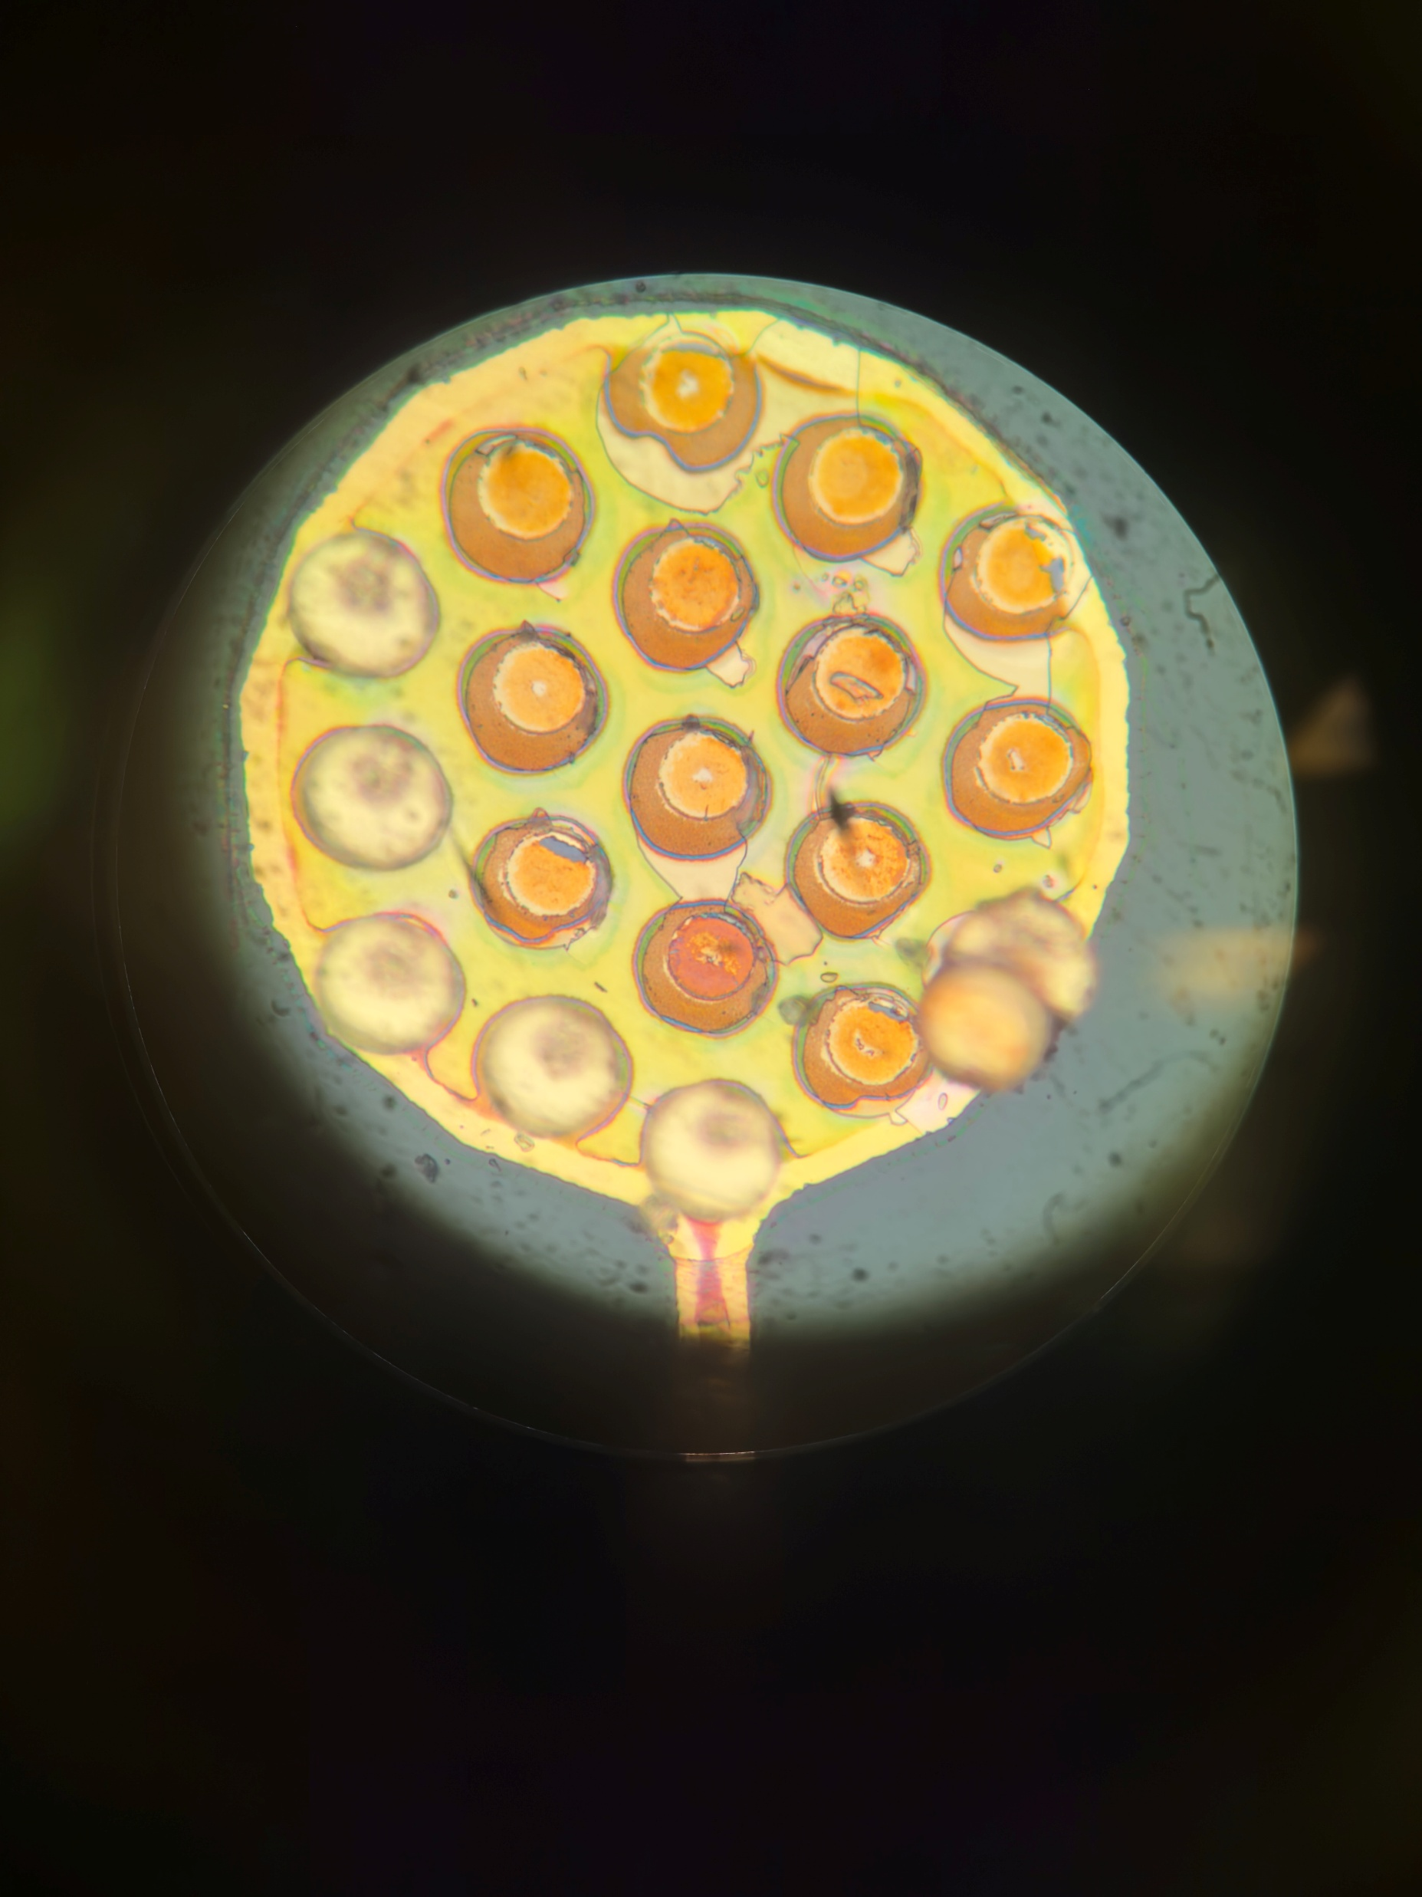
A22 Nearside
Post Pull Test
Better alignment of Pads

Slide 4
A22 Nearside
Post Pull Test
7.6um
5.9um
Better alignment of Pads
Not much of a difference vs the non-annealed where vias have broken off.
Vias have height of 5.9um
Vias with misalignment are 7.6um.
Visually inspecting shows that top of the vias

Slide 5
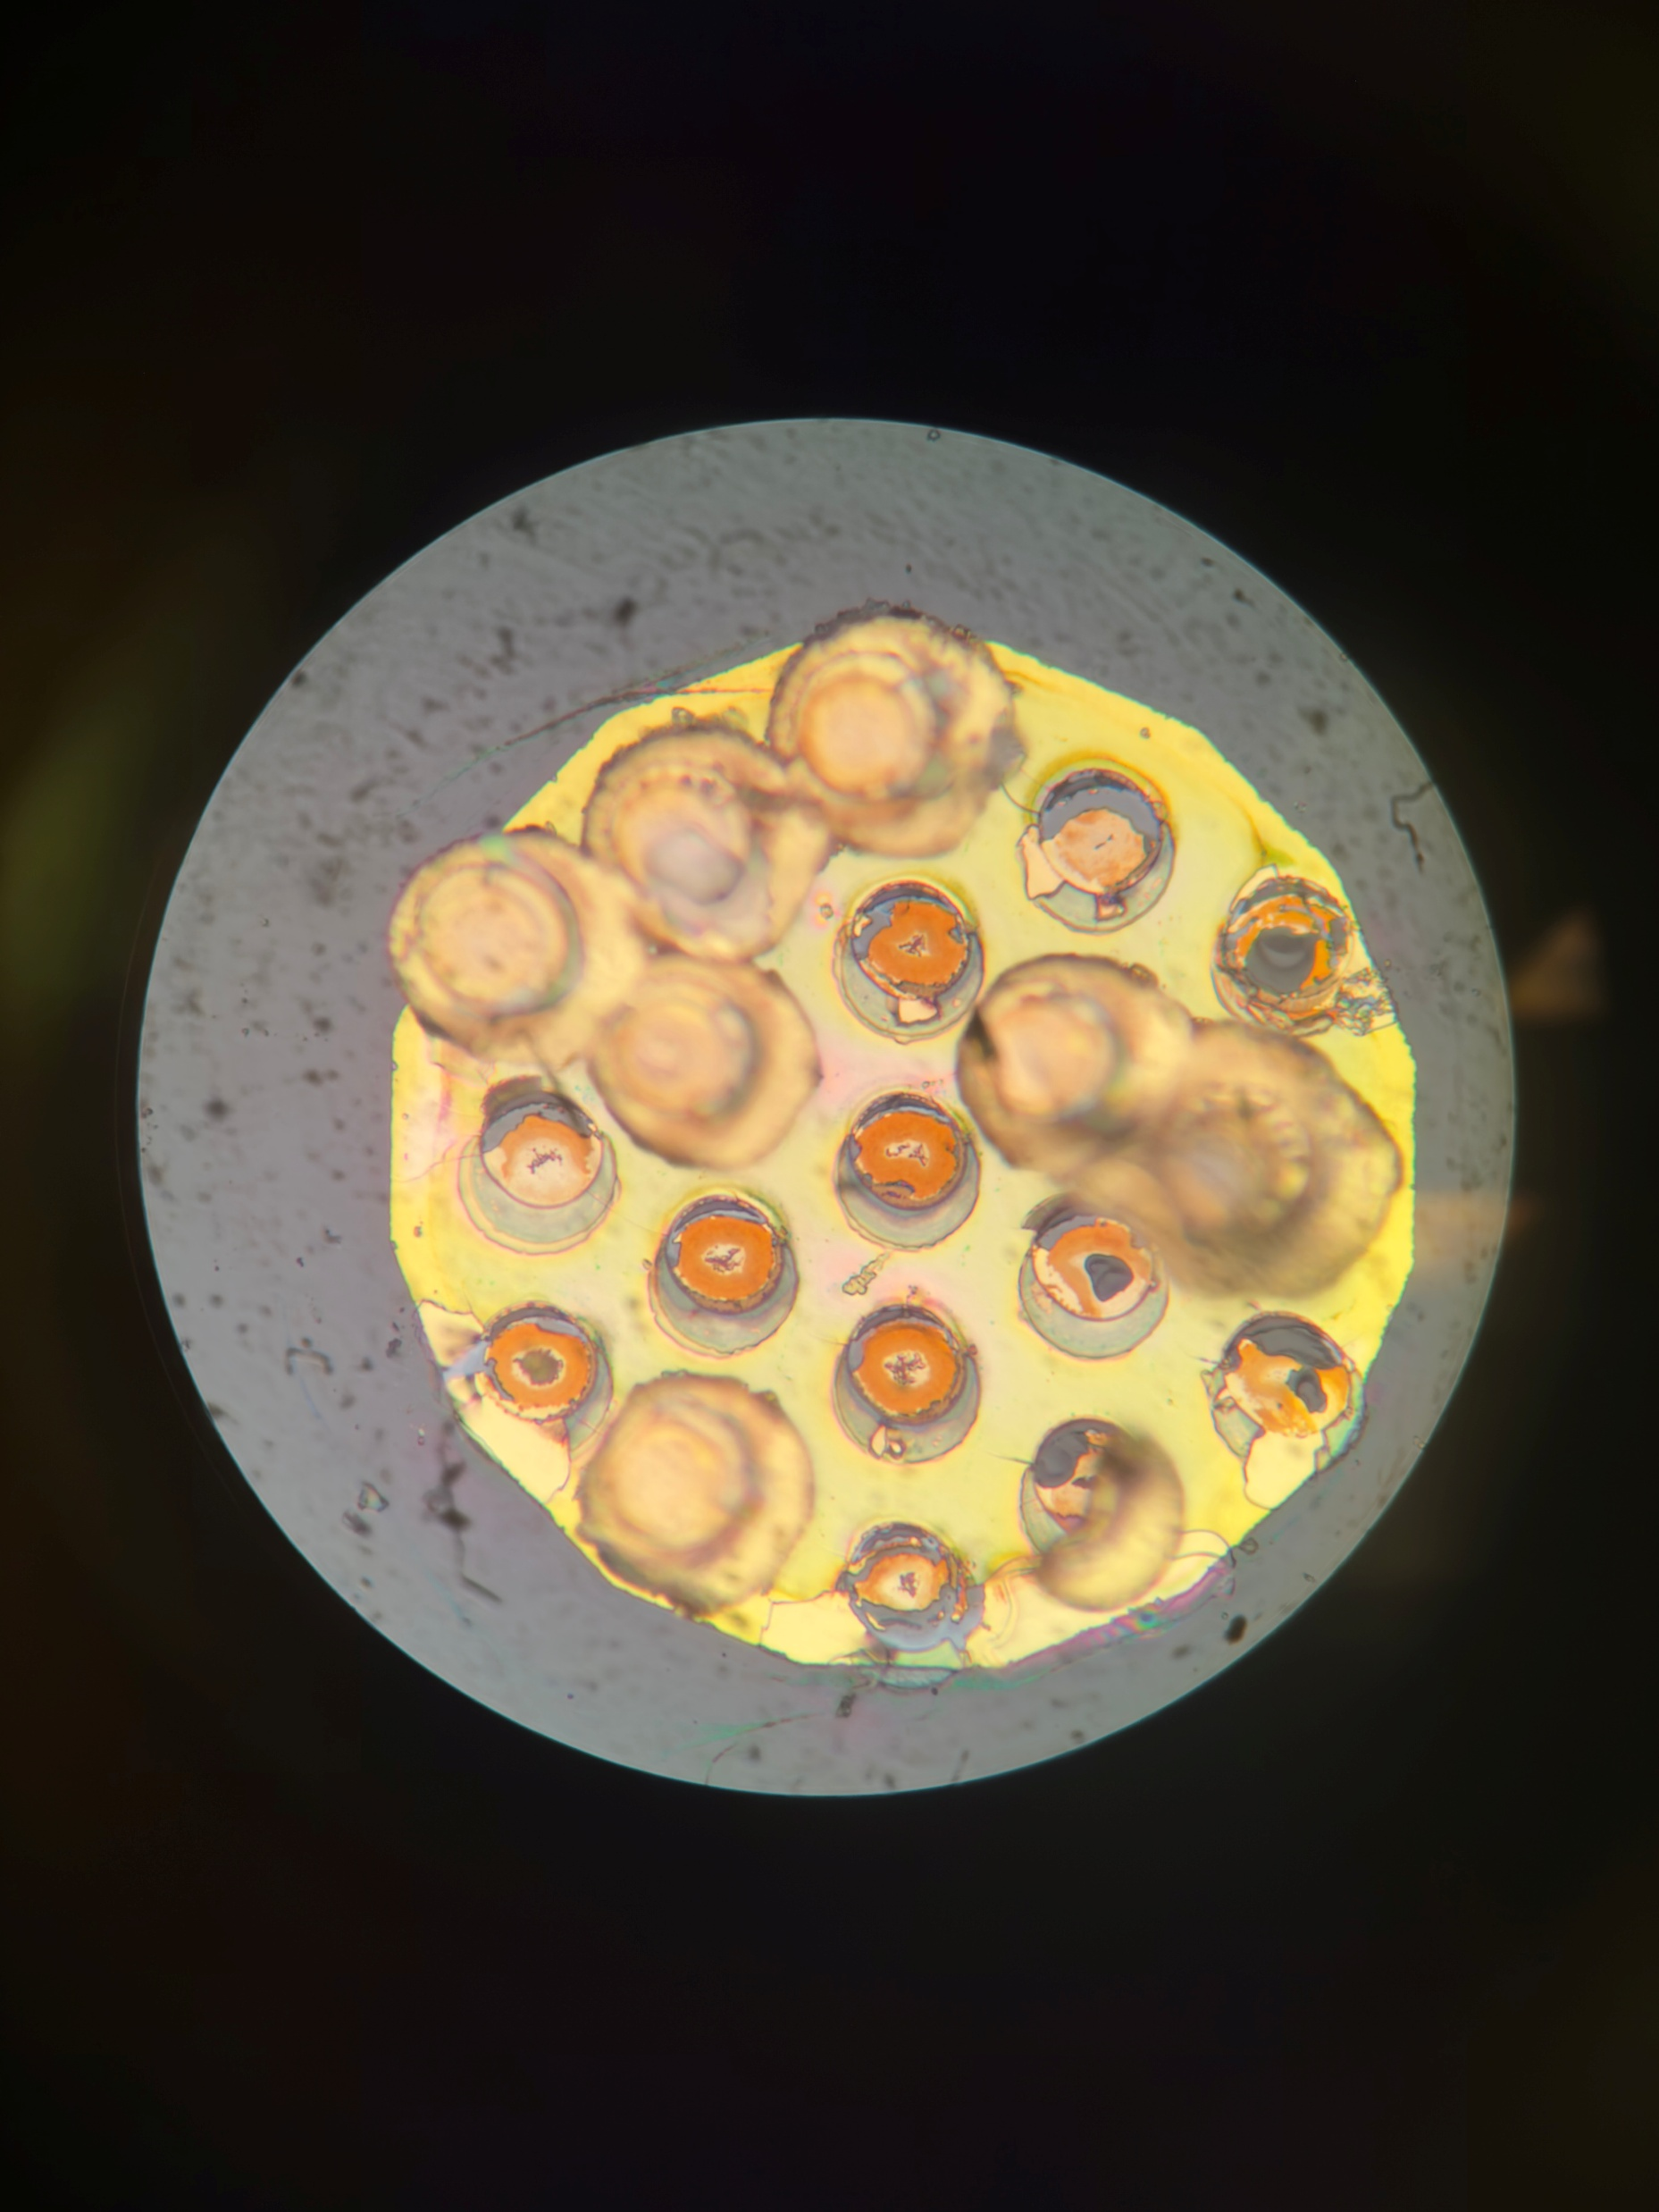
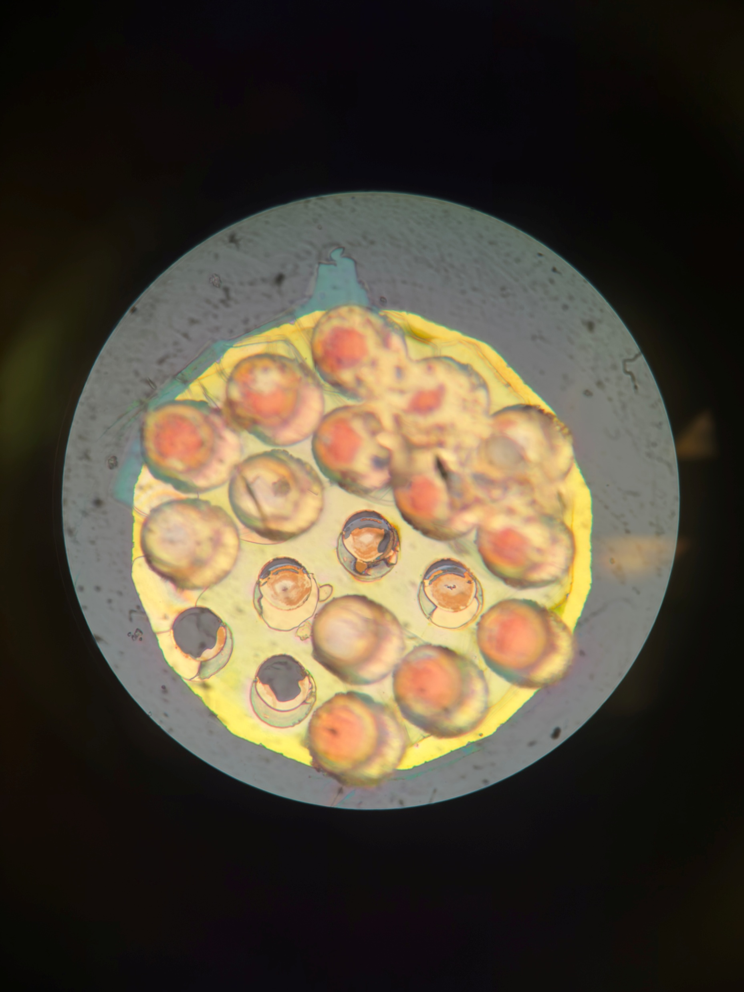
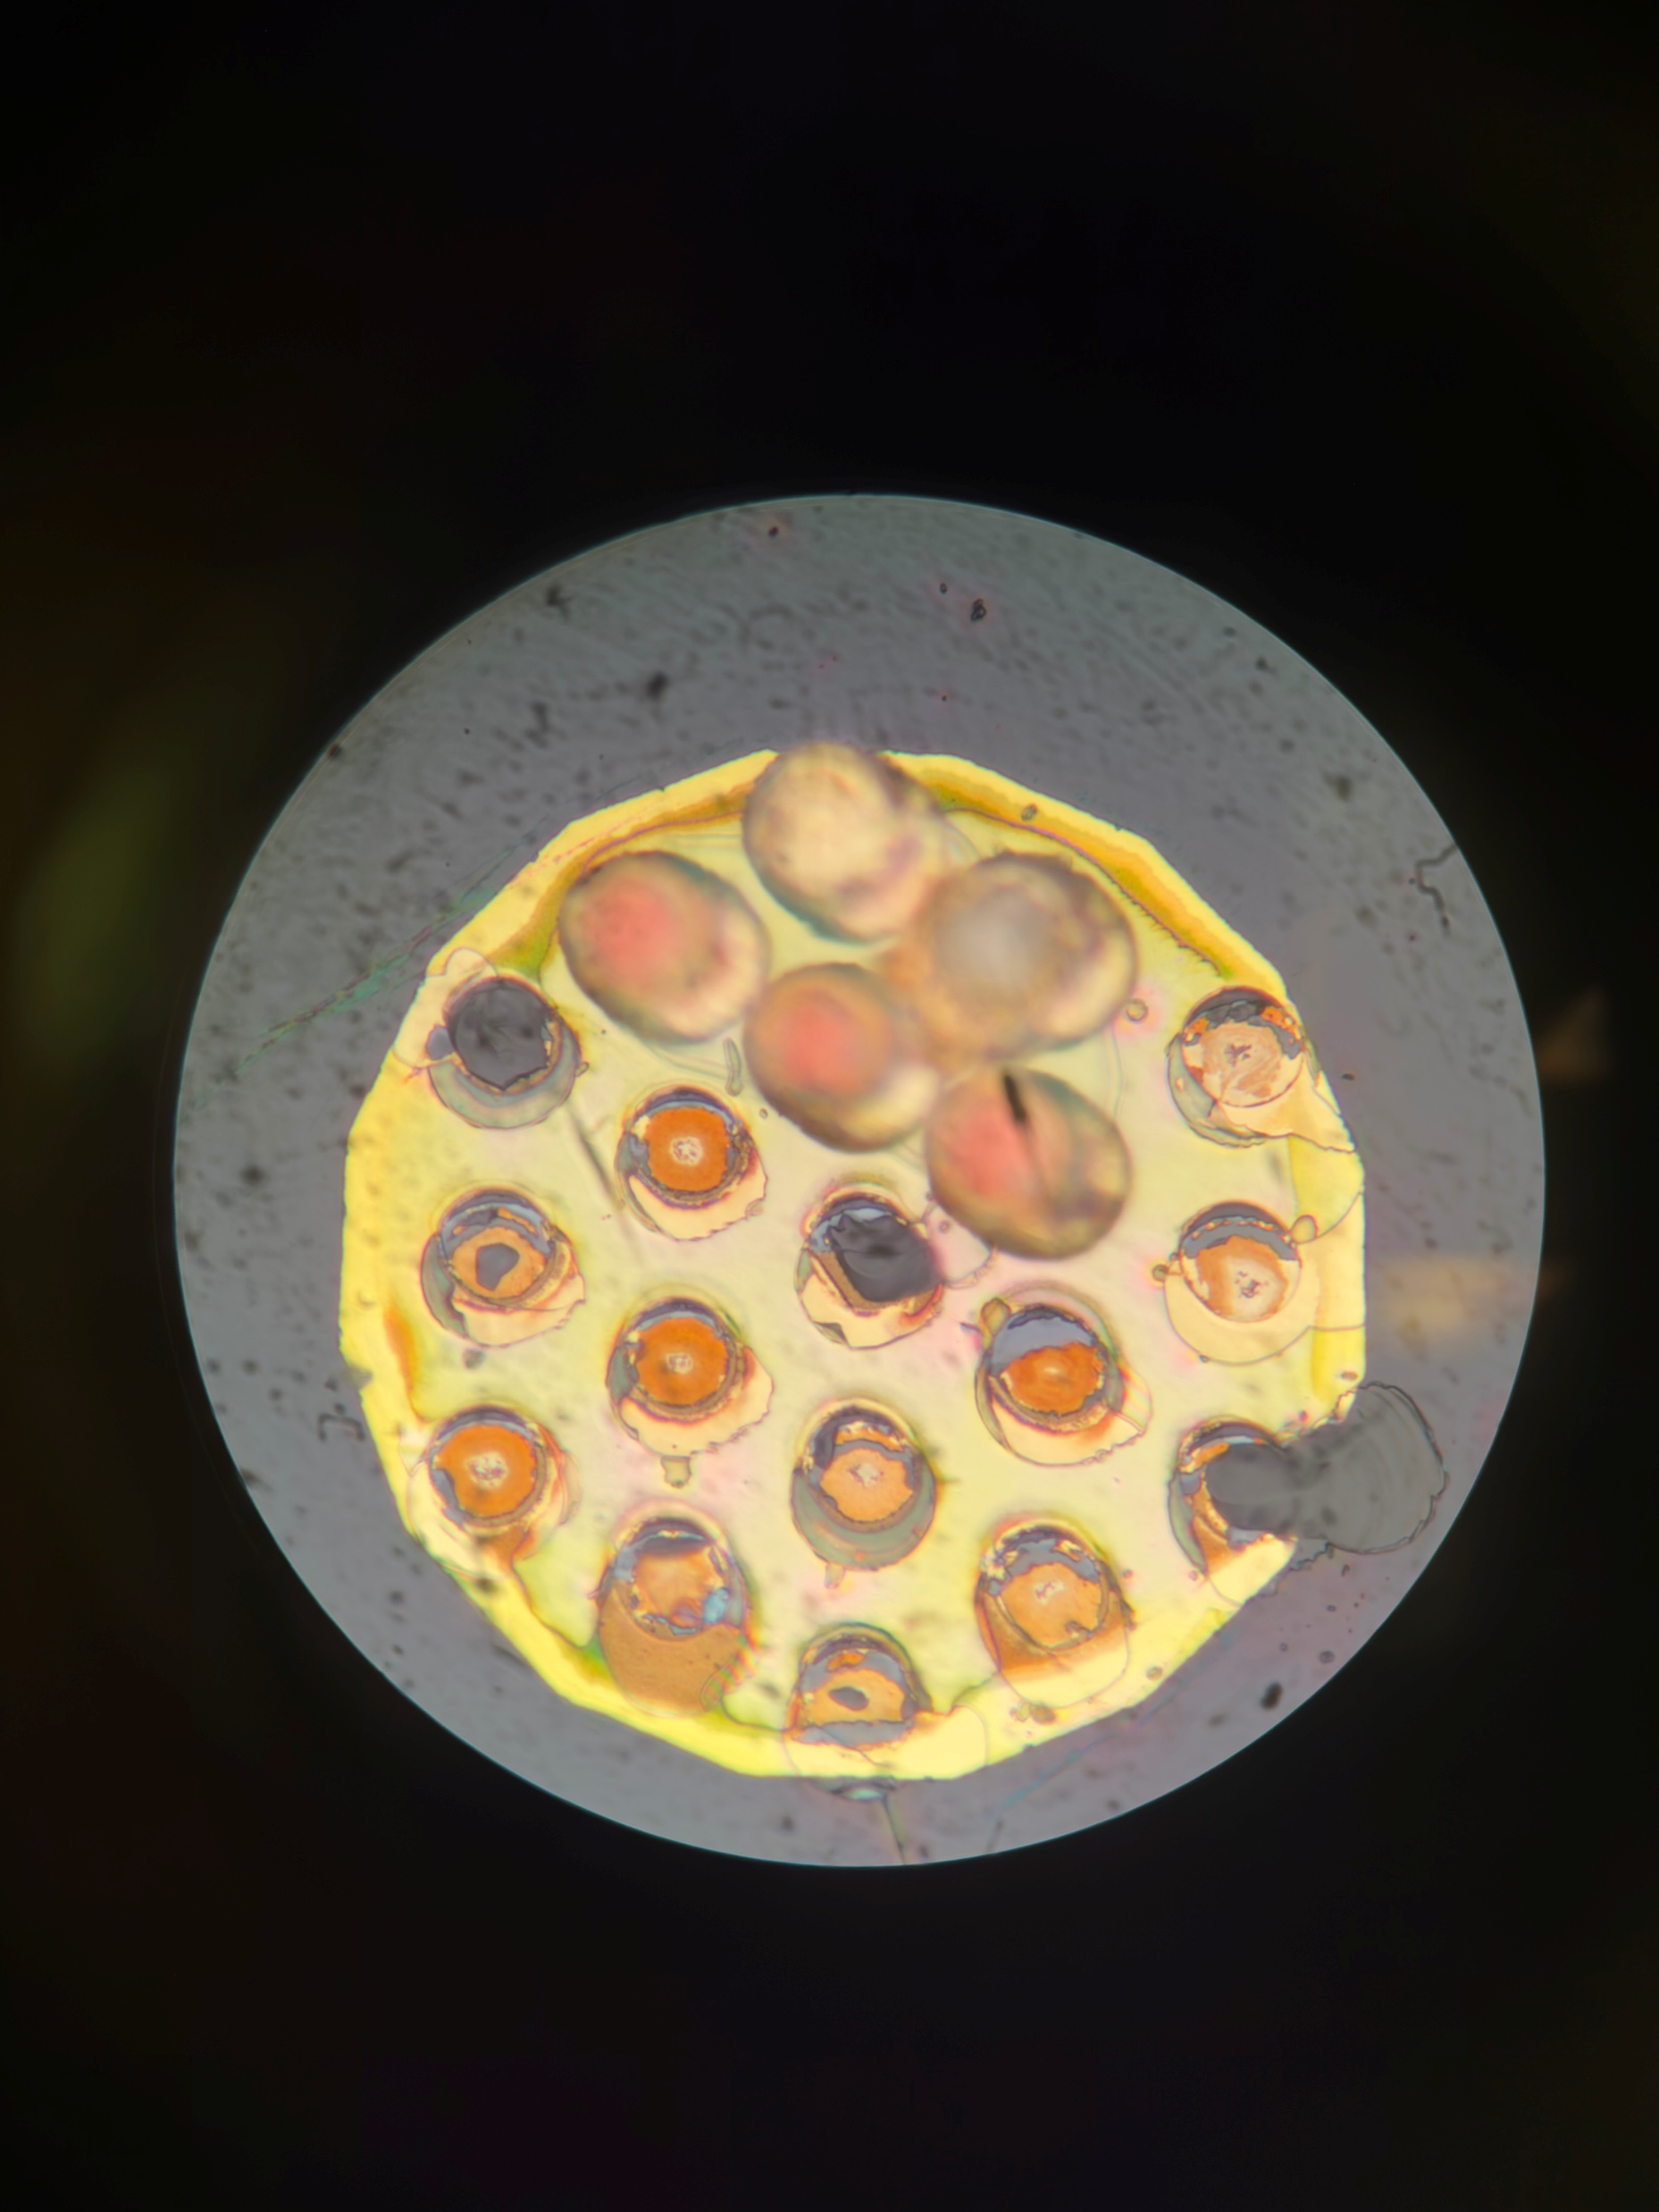
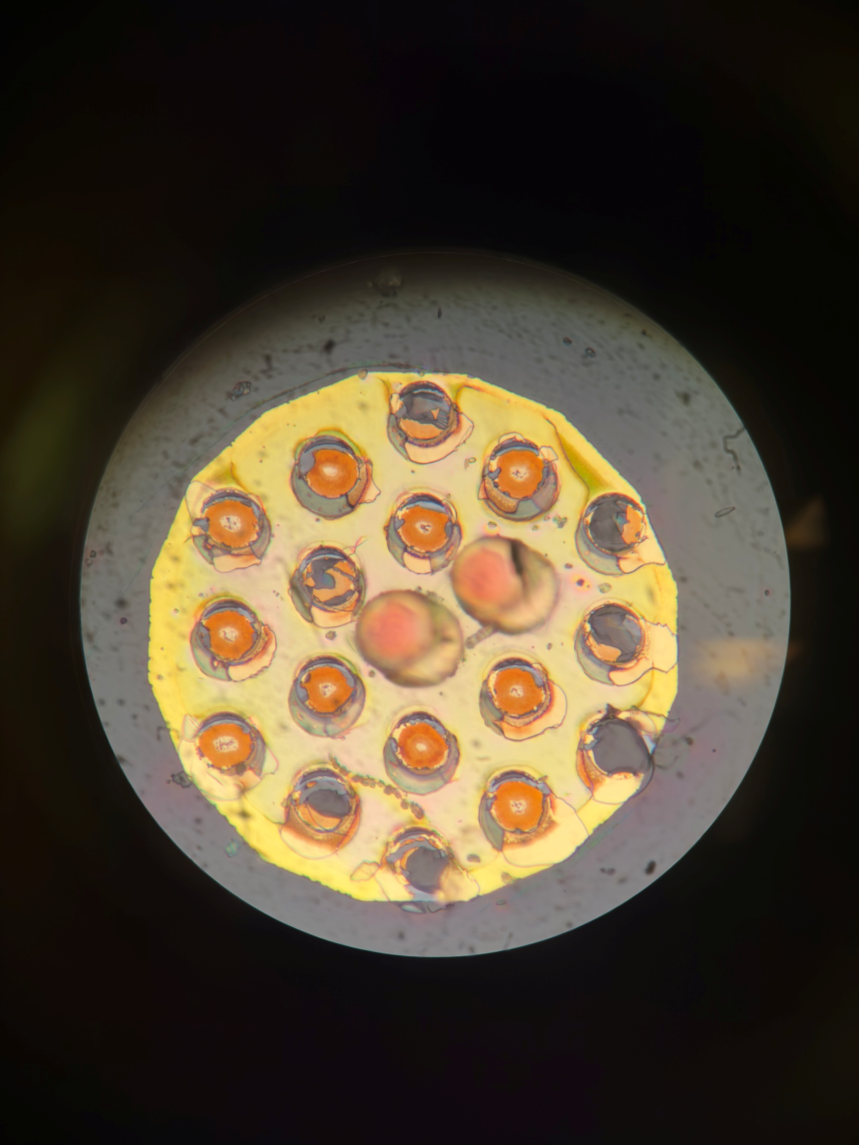
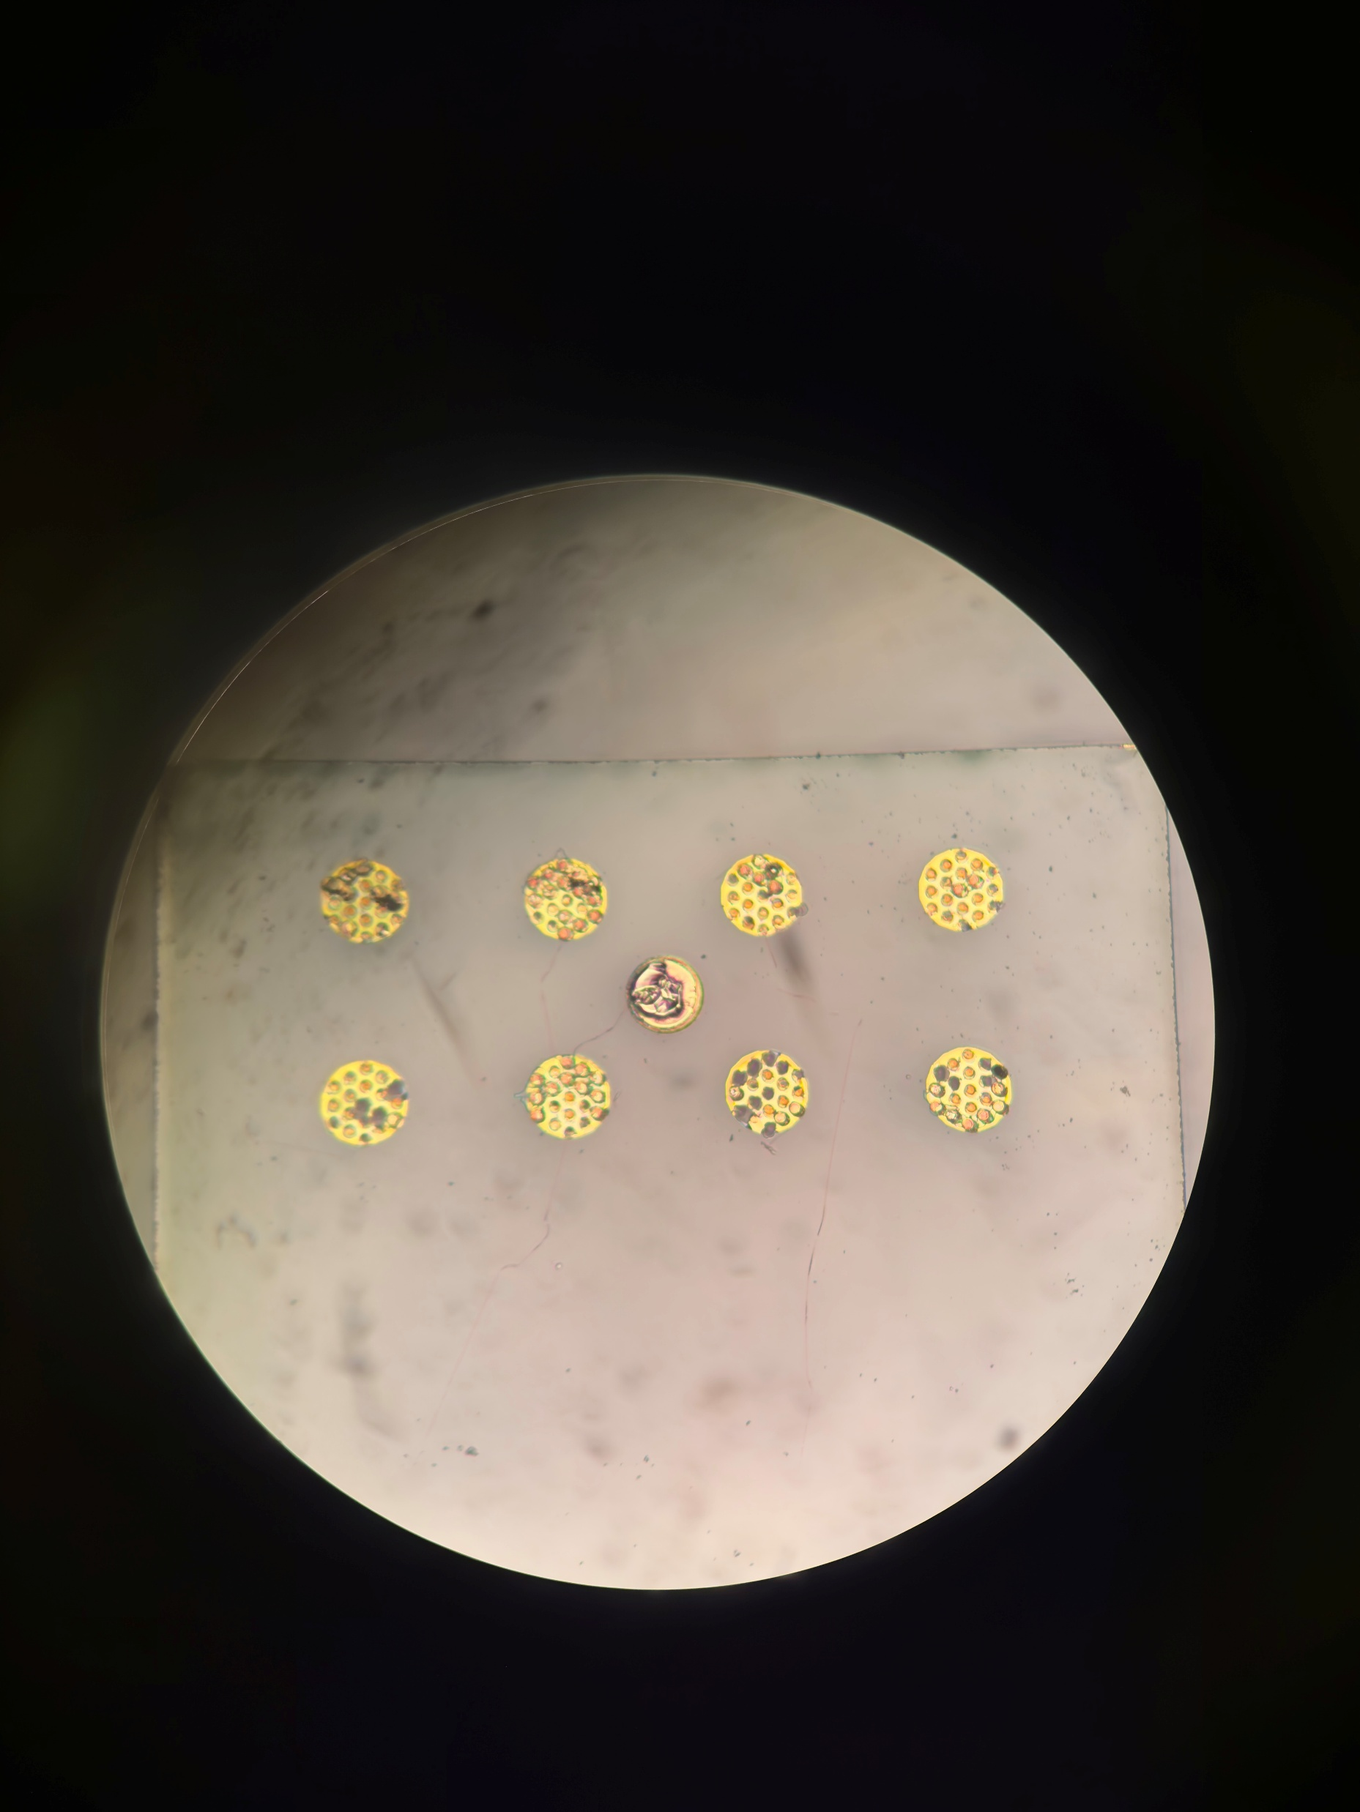
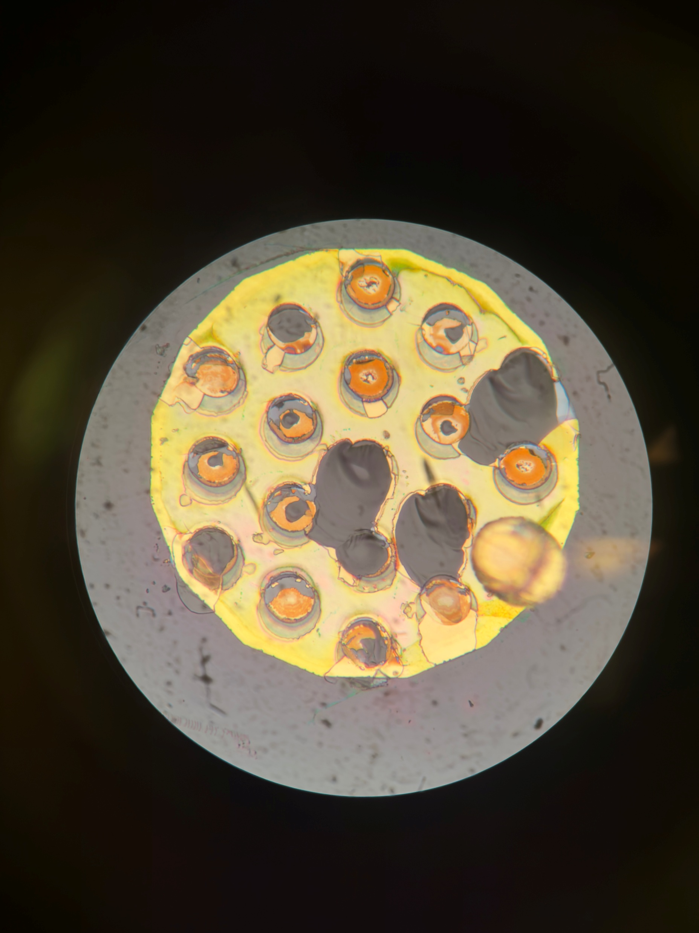
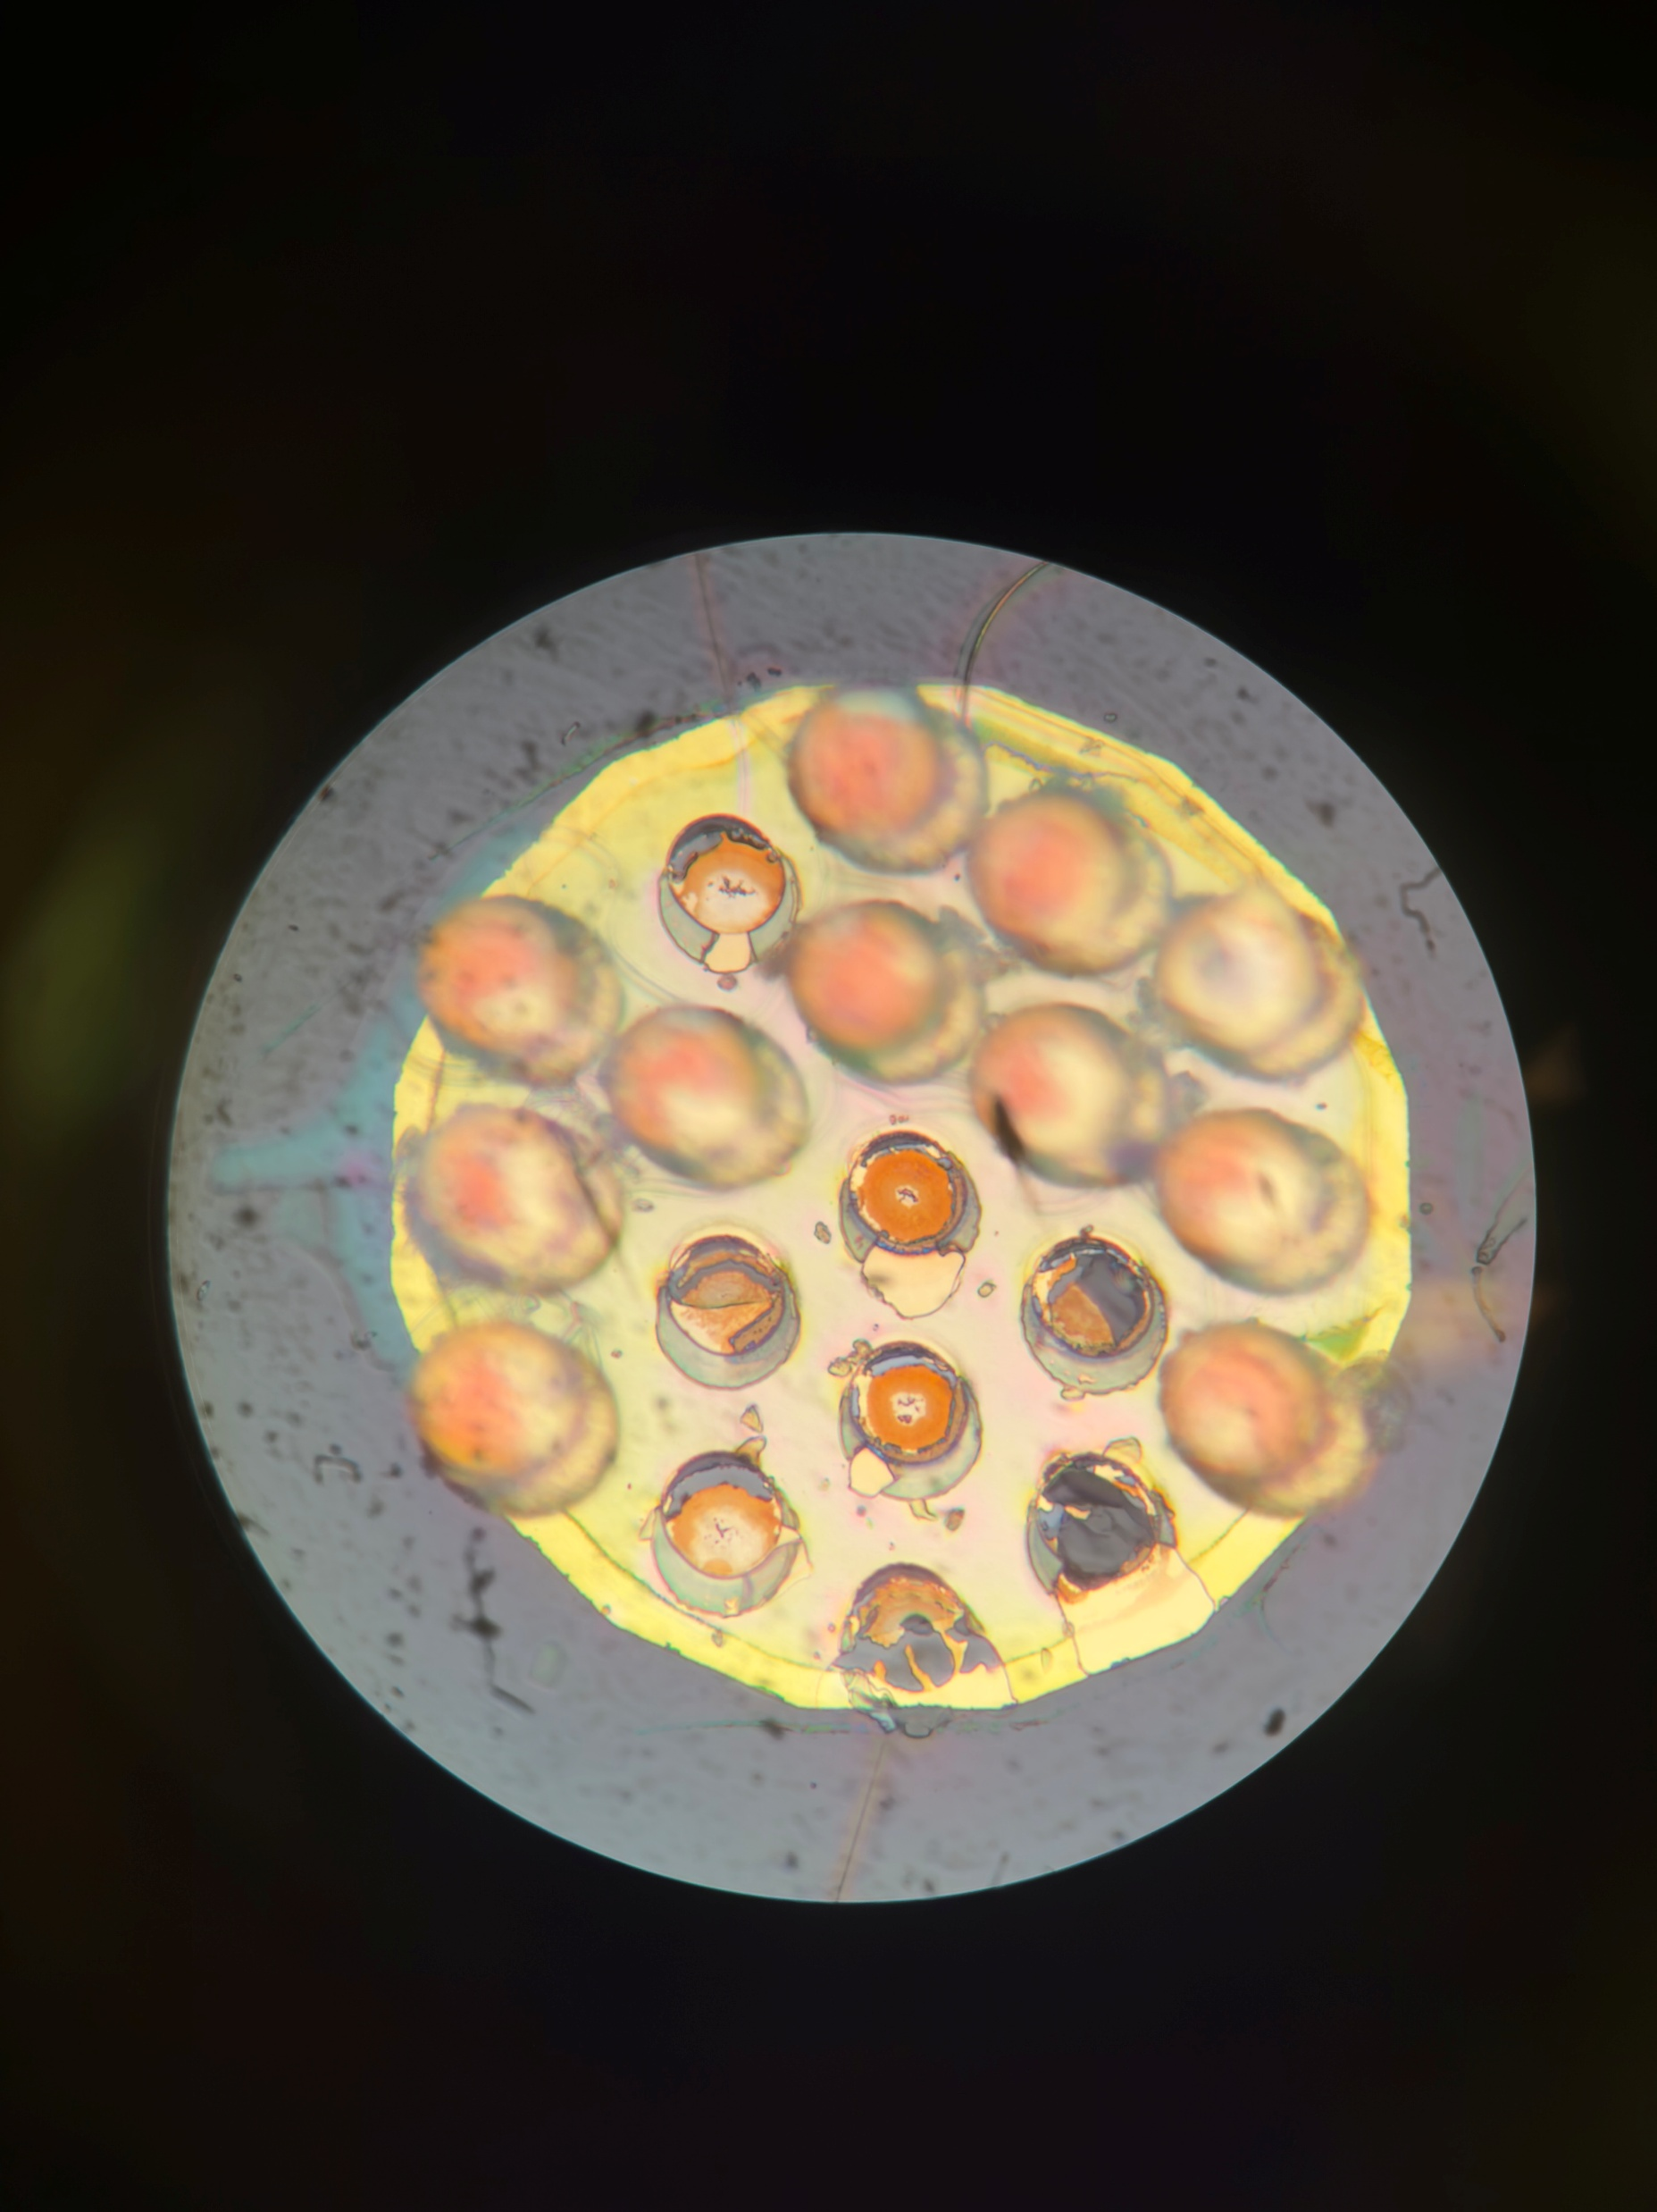
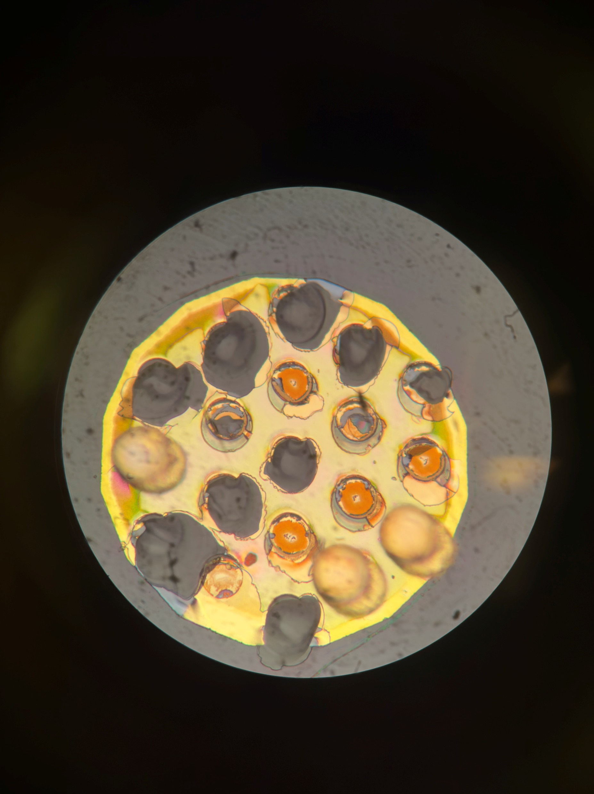
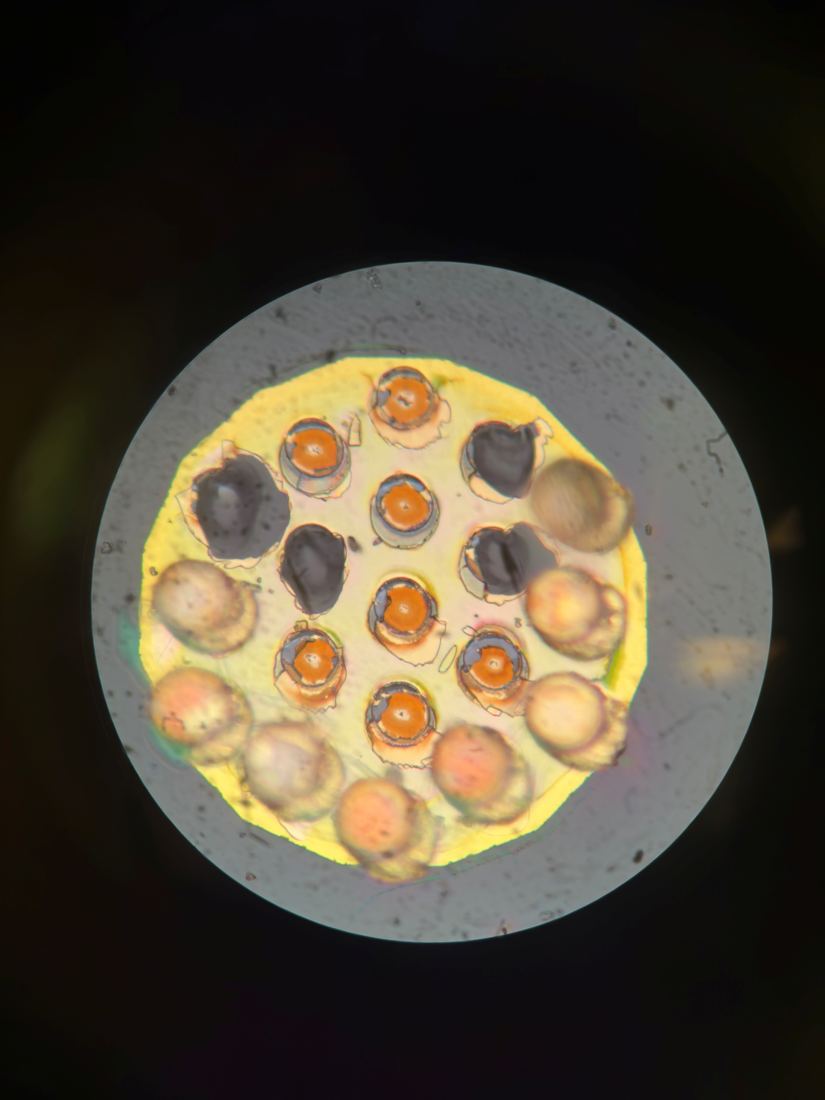
A22 Farside
Post Pull Test
Better alignment of Pads
Notes:
Total of 28 Glass failures
Failure of gold is more common. ( approx. 120)
Minimal number of titanium-gold failure (3)

Slide 6
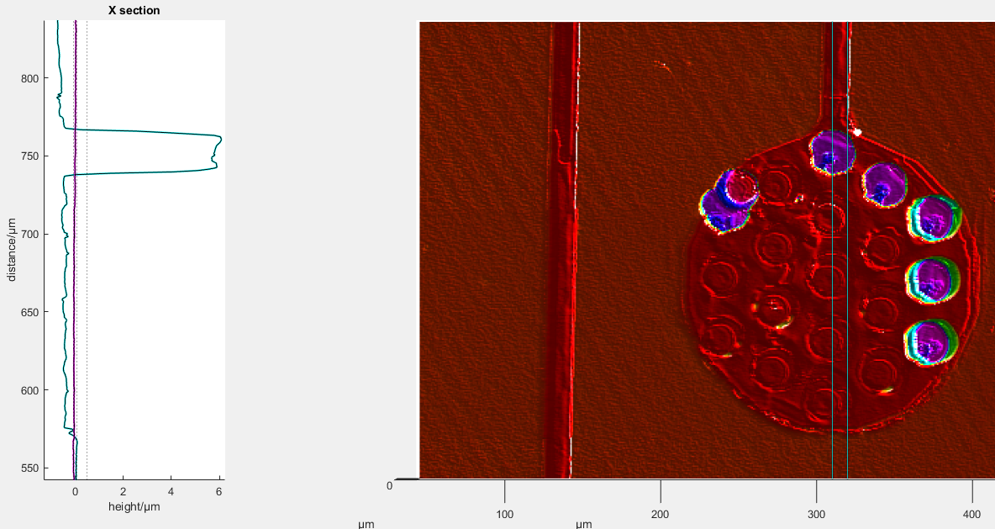
A22 Nearside Pad 1
Post Pull Test
-0.556657 um
-0.369891 um
--0.427889um
-0.371221 um
Notes:
What this shows is that majority of failures still occur in the gold layer – not down to the adhesion layer – need to support it more.
Either make the vias larger or do some bevelling (may not be possible with the process)
Bottom of vias is -0.2um deeper than the area removed with the PEVCD – but still not to adhesion layer.
Same failure as without anneal.

Slide 7
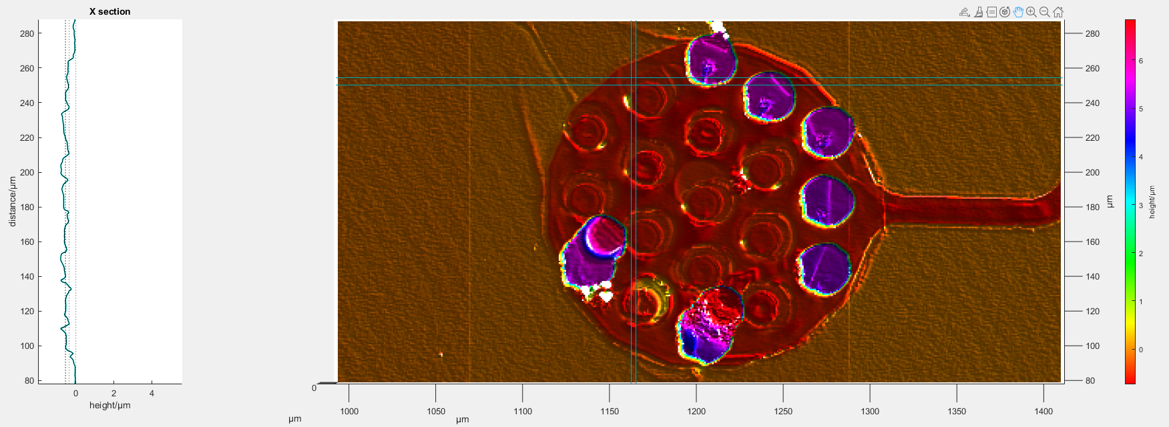
A22 Nearside Pad 7
Post Pull Test
-0.787184um
-0.541437um
Notes:
What this shows is that majority of failures still occur in the gold layer – not down to the adhesion layer – need to support it more.
Either make the vias larger or do some bevelling (may not be possible with the process)
Bottom of vias is -0.2um deeper than the area removed with the PEVCD – but still not to adhesion layer.
Same failure as without anneal.

Slide 8
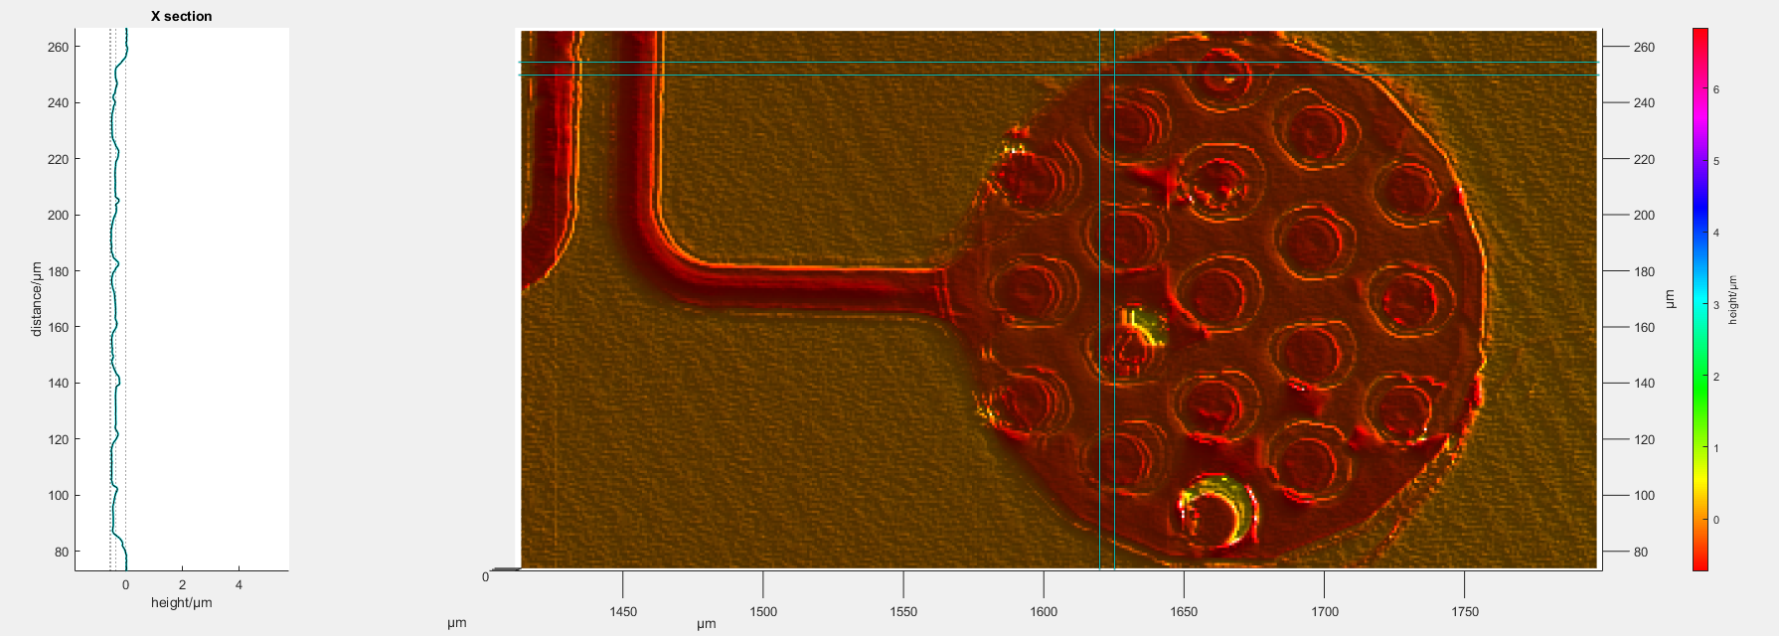
A22 Nearside Pad 8
Post Pull Test
-0.53957um
-0.503499um
Notes:
What this shows is that majority of failures still occur in the gold layer – not down to the adhesion layer – need to support it more.
Either make the vias larger or do some bevelling (may not be possible with the process)
Bottom of vias is -0.2um deeper than the area removed with the PEVCD – but still not to adhesion layer.
Same failure as without anneal.

Slide 9
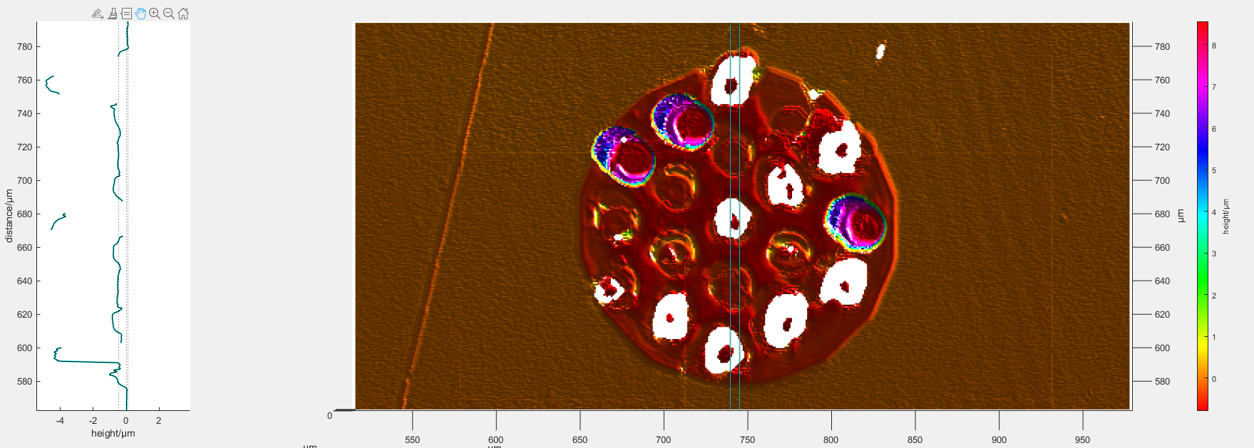
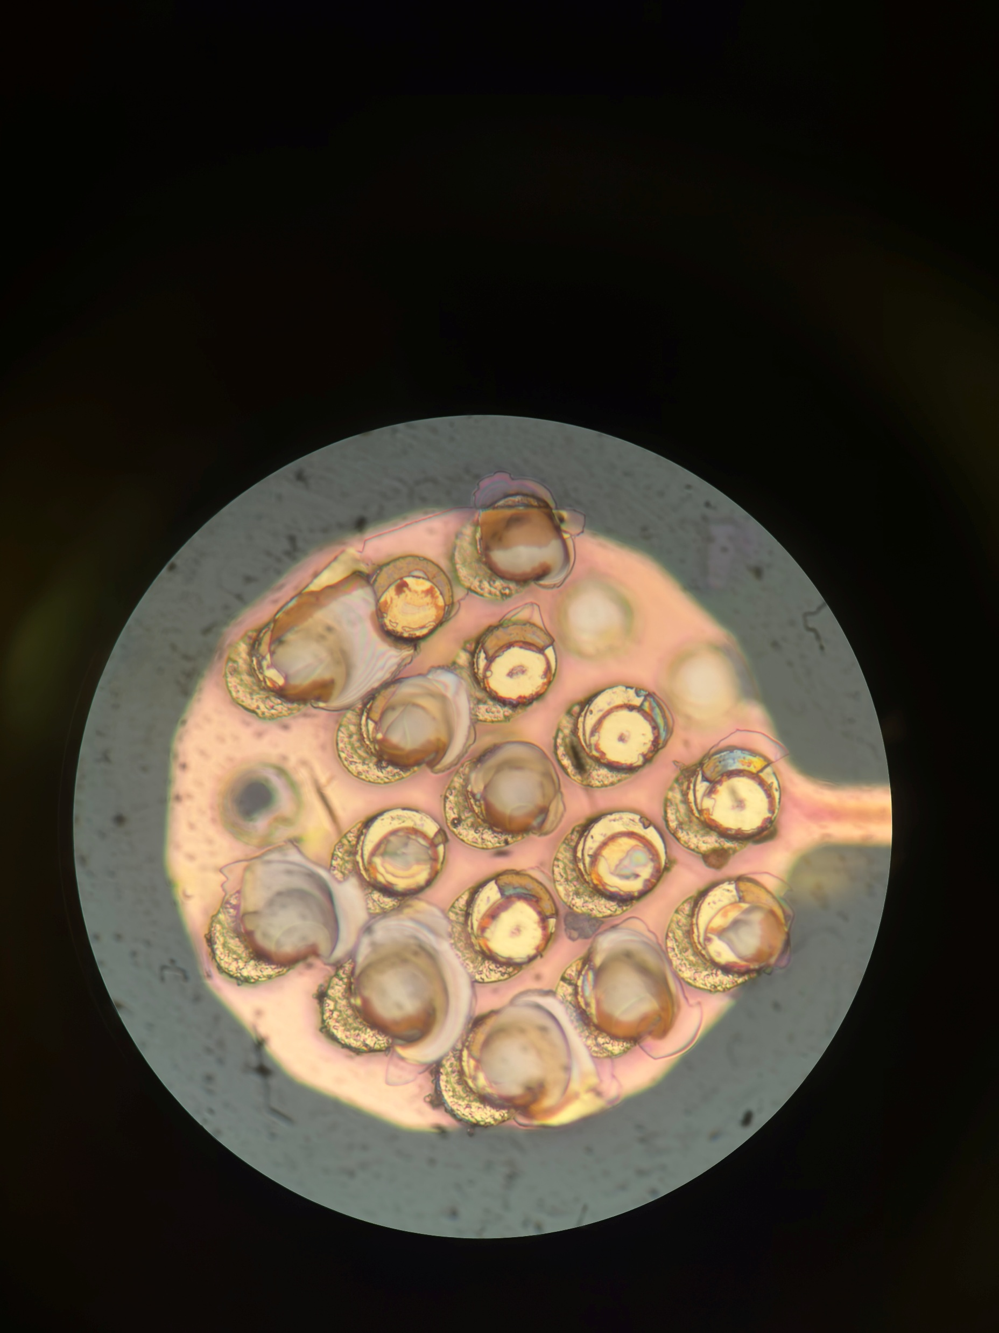
A22 Farside Pad 2
Post Pull Test
-0.780919um
-0.351009um
Better alignment of Pads
-4.88138um
-0.474777um
-0.737305um
-4.49165um
Notes:
Definite signs of glass failure

Slide 10
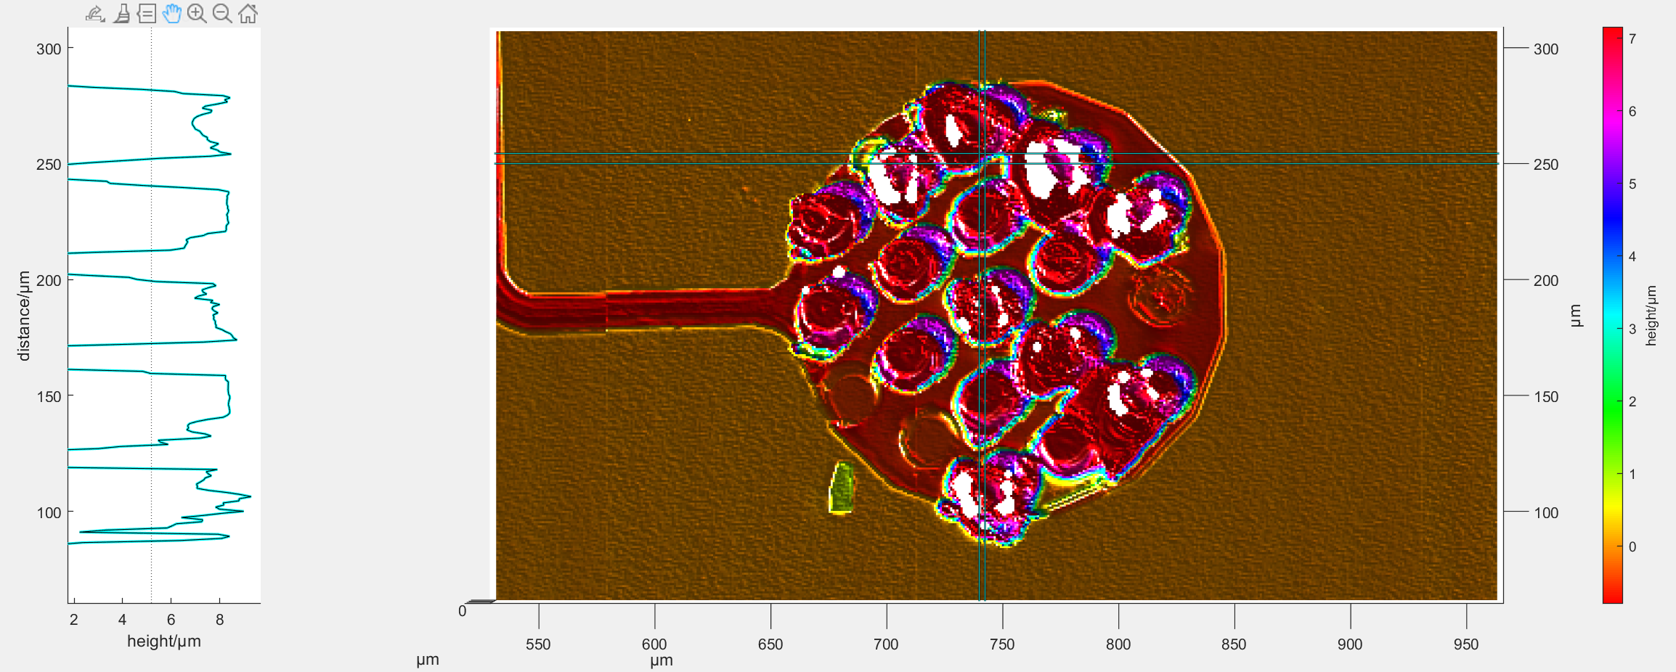
A25 Nearside Pad 2
Post Pull Test
8.33178um
Better alignment of Pads
9.30099um
8.71722um
6.53728um
8.28577um
Notes:
Definite signs of glass failure

Slide 11
A22 Farside Pad 2
Post Pull Test
B
A
B
Delamination of lower layers pulling up the height
A
Failure seen in Glass (3),
Gold Via (2) (Bulk gold)

Slide 12
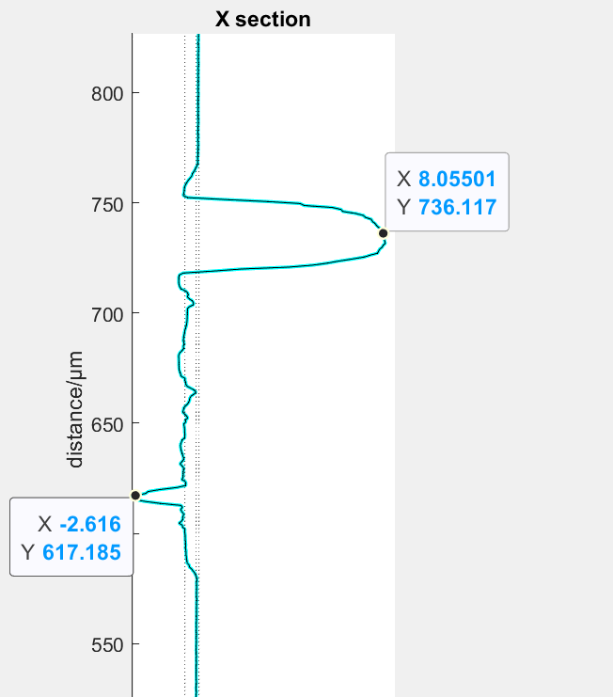
A22 Farside Pad 2
Post Pull Test
B
A
-1.2um
B
Pulled Up PECVD
Delamination of lower layers pulling up the height
A
Failure seen in Glass (1),
Gold Via (2) (Bulk Gold)
Gold-Titanium Layer (1)

Slide 13
A22 Farside Pad 2
Amount of Gold-Gold Bonding
A
B
9 Vias gold failed
9 Vias glass failed
1 Via titanium-gold failed

Slide 14
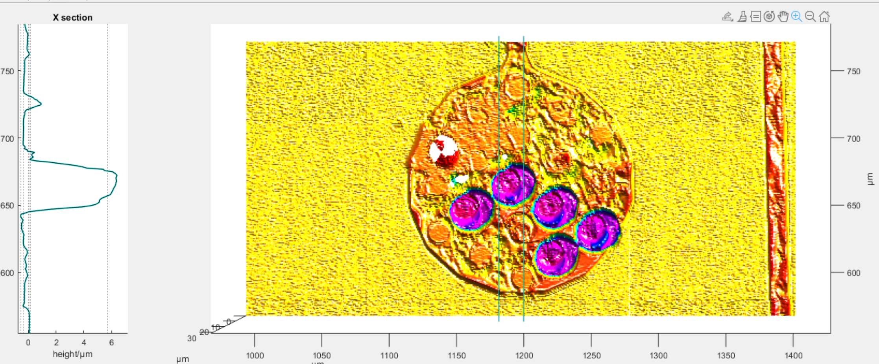
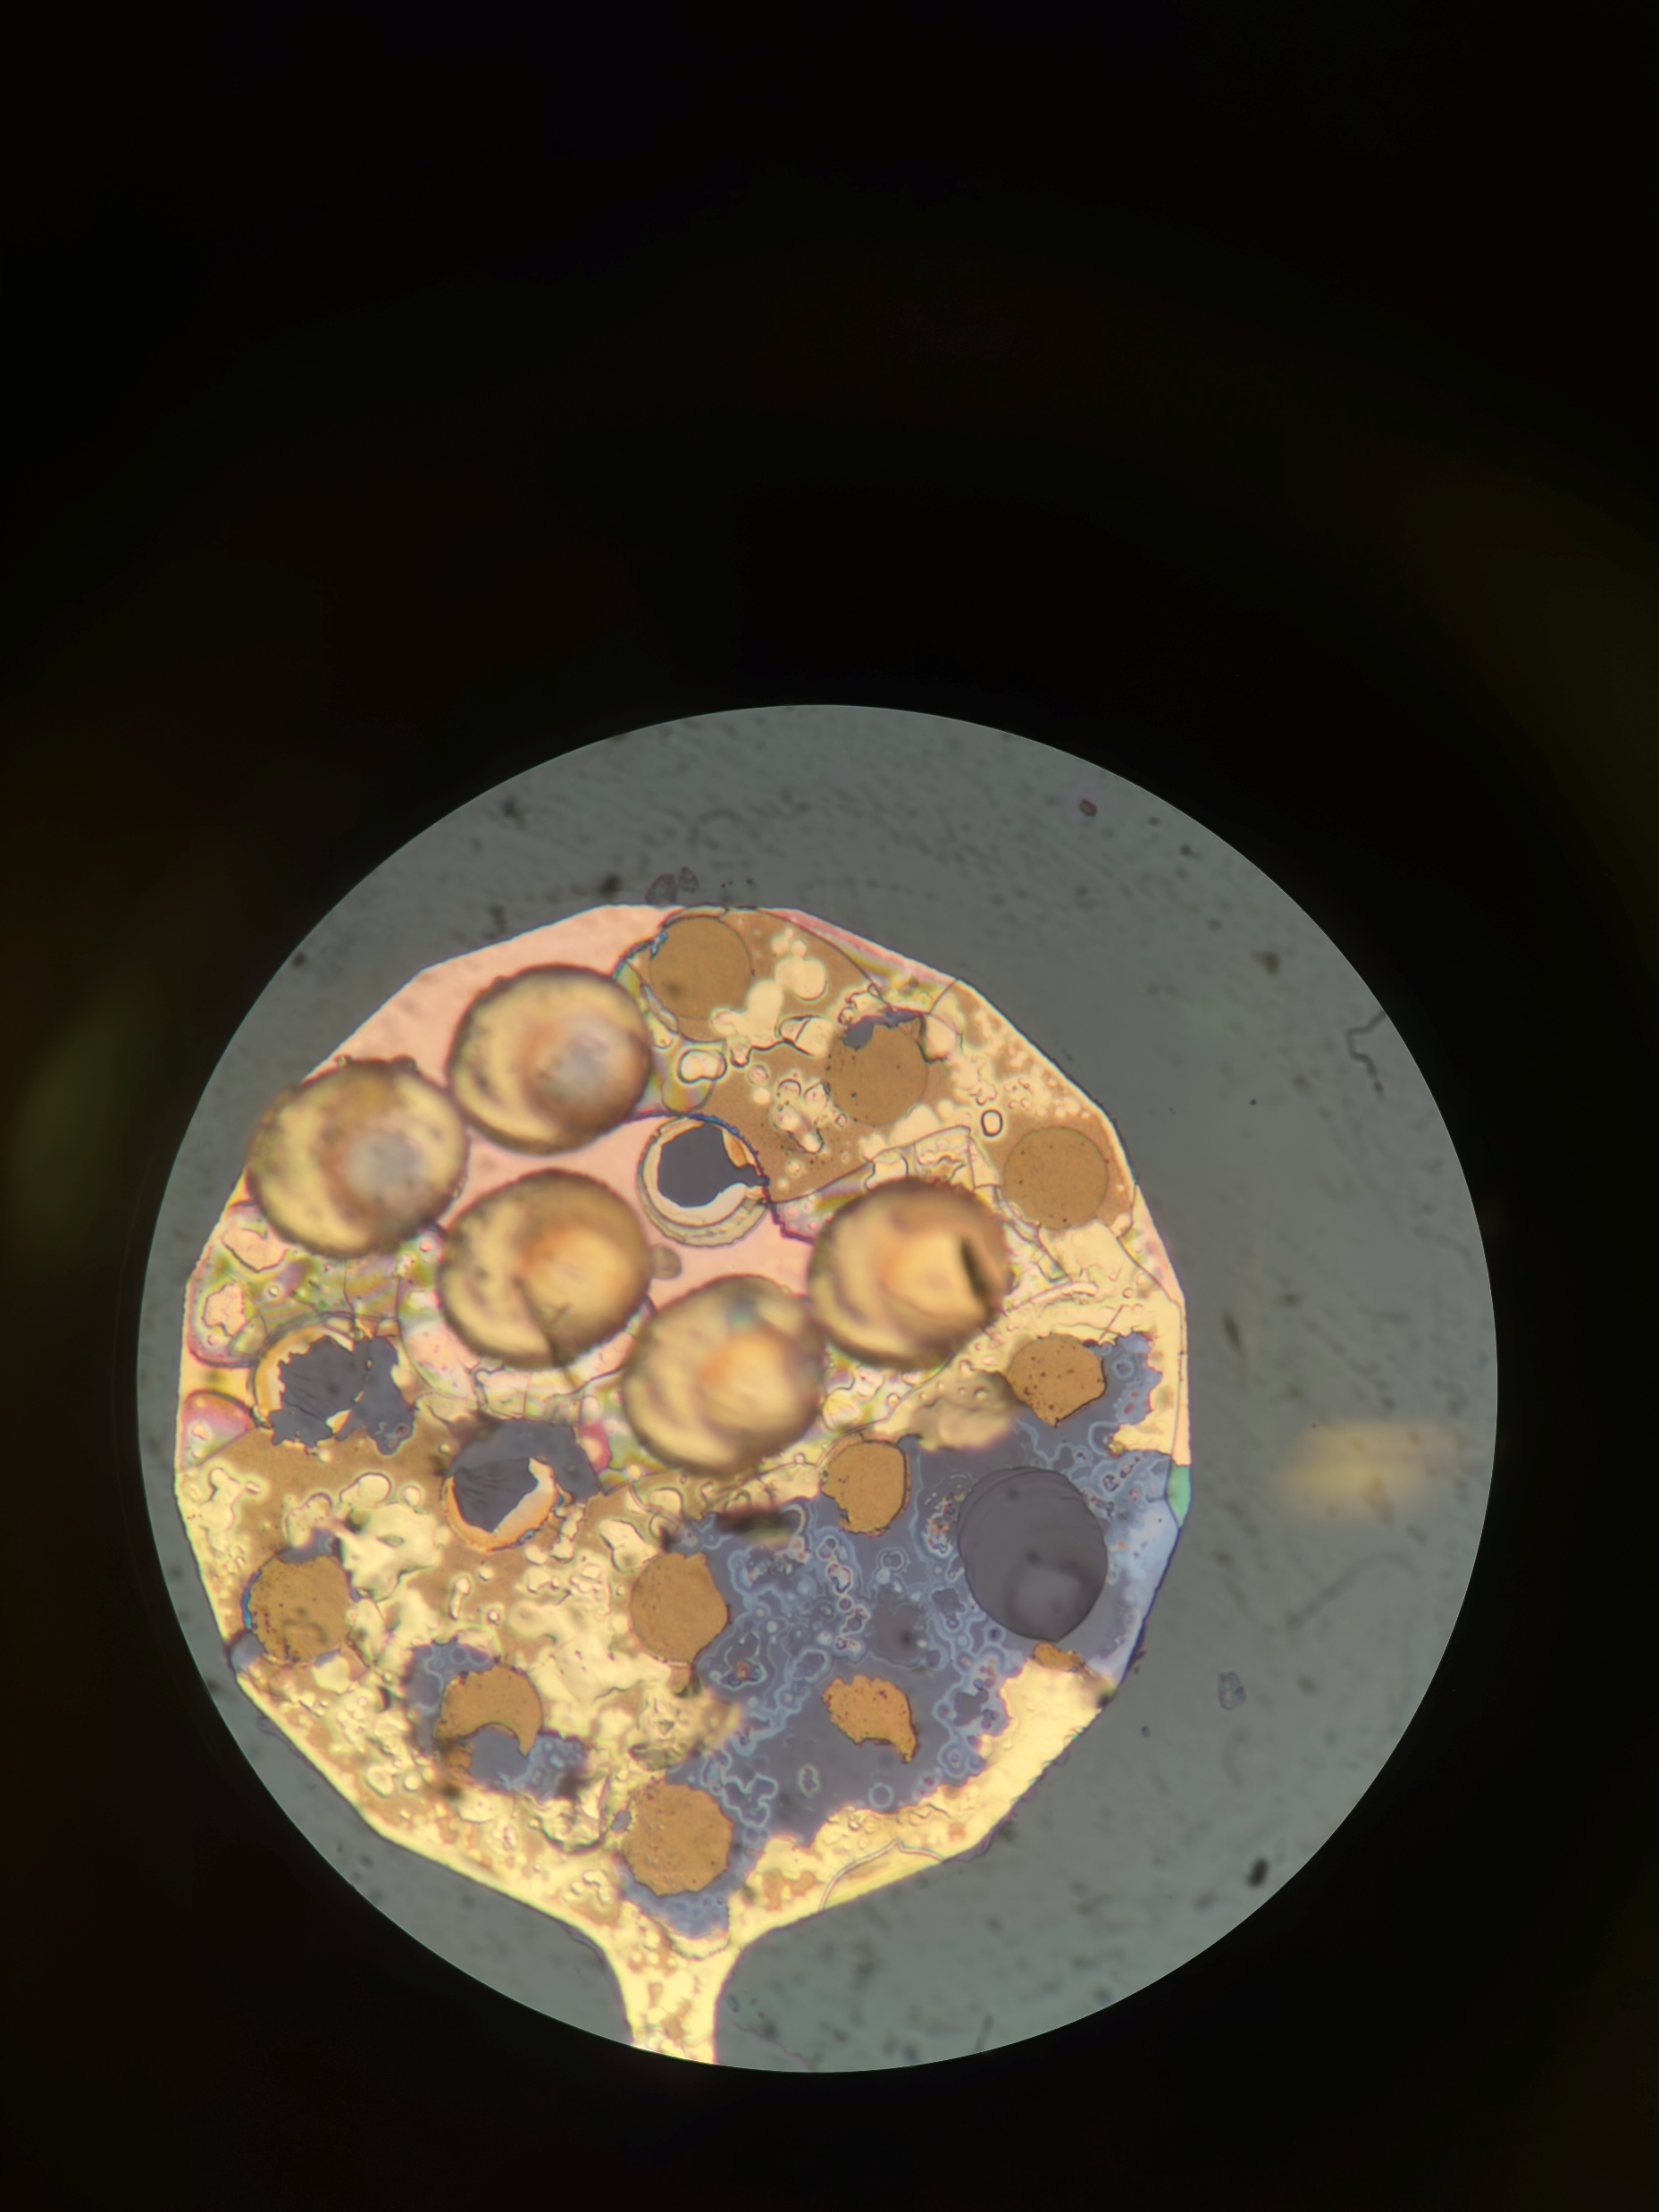
A25 Farside Pad 7
Post Pull Test
-0.2984um
-0.354626um
6.548um
-0.5135um
-0.2292um

Slide 15
A25 Farside Pad 7
Post Pull Test
PECVD Coating
Gold
Adhesion Layer
Layer beneath titanium

Slide 16
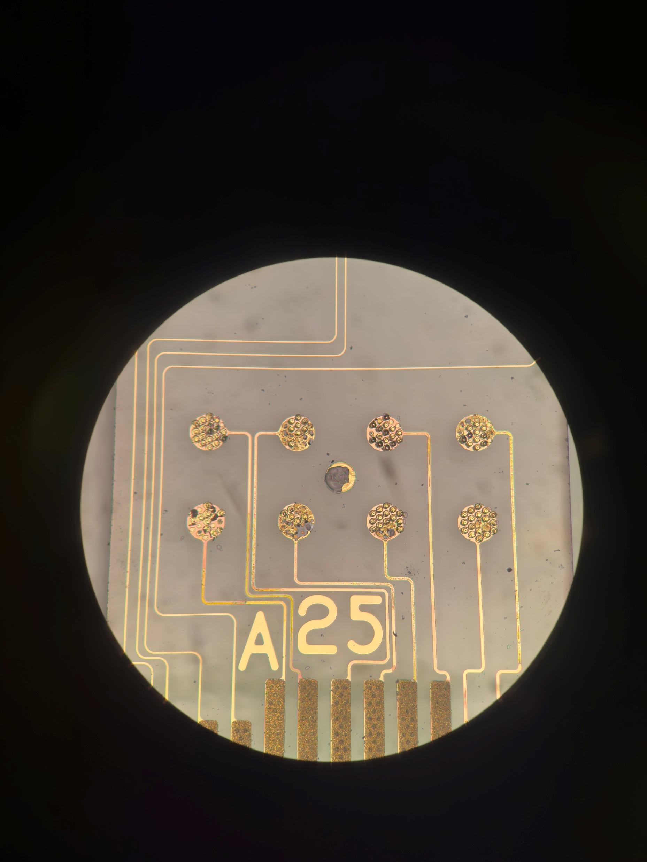

Slide 17
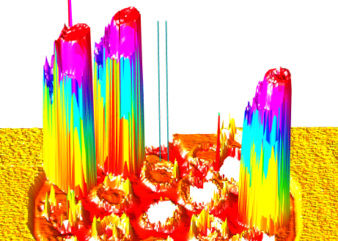
Thoughts so far
Bonds are mainly failing in the gold
As the bond is pulled, the gold stretches and hence shows extension of 0.2um above the bottom.
Sometimes PECVD remains attached on top, sometimes flakes off
Curves up the gold layer underneath
2 Main modes of failure, gold failure and glass failure
Glass failure is created right underneath each via, and pulls out some glass from underneath.

Slide 18
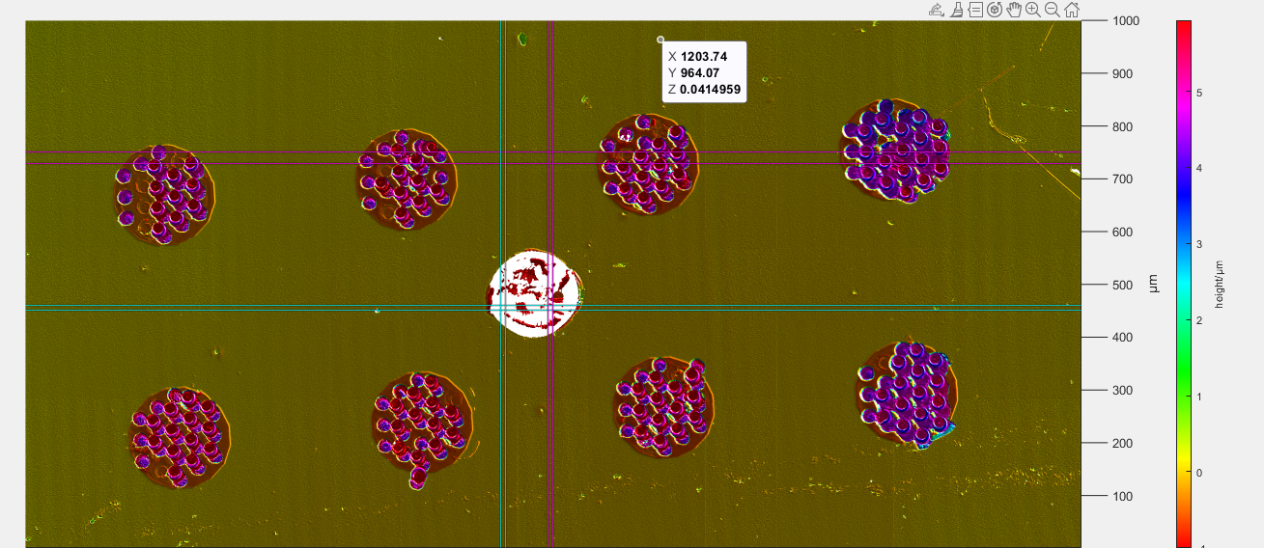
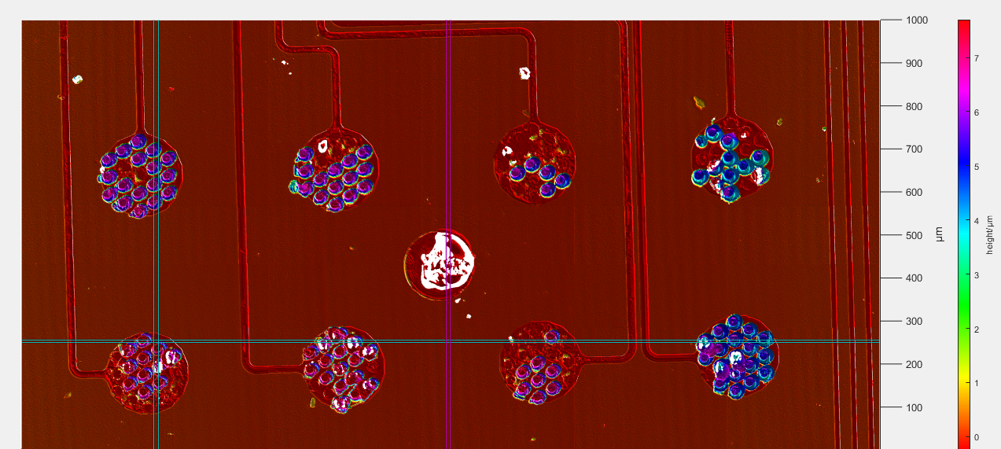
A25
Post Pull Test
Better alignment of pads

Slide 19
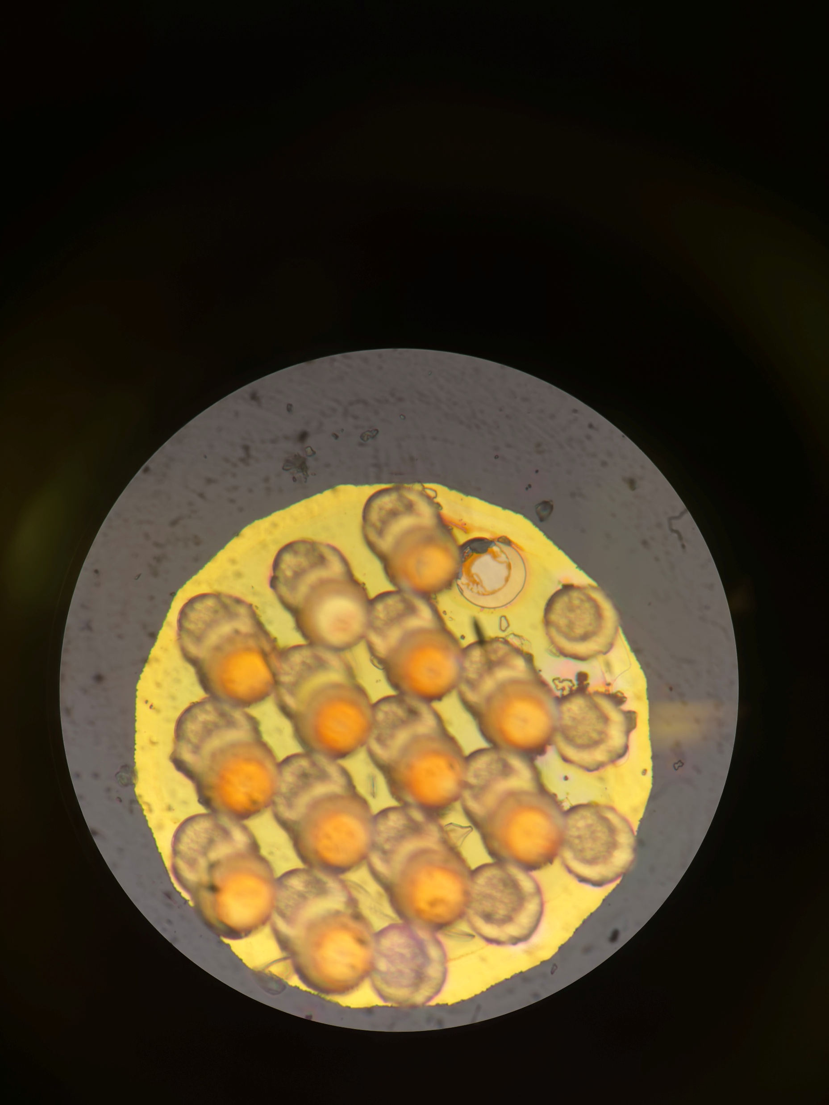
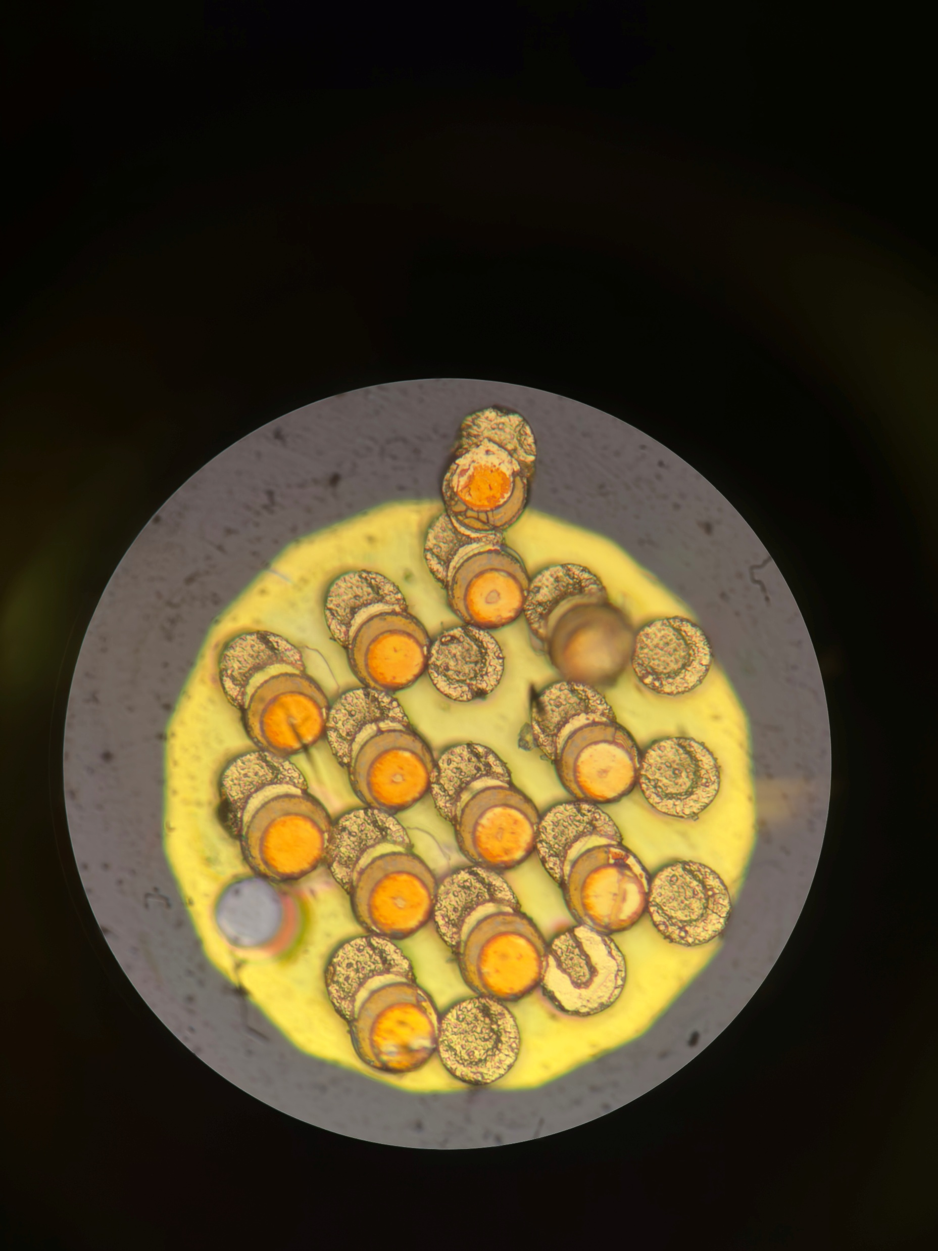
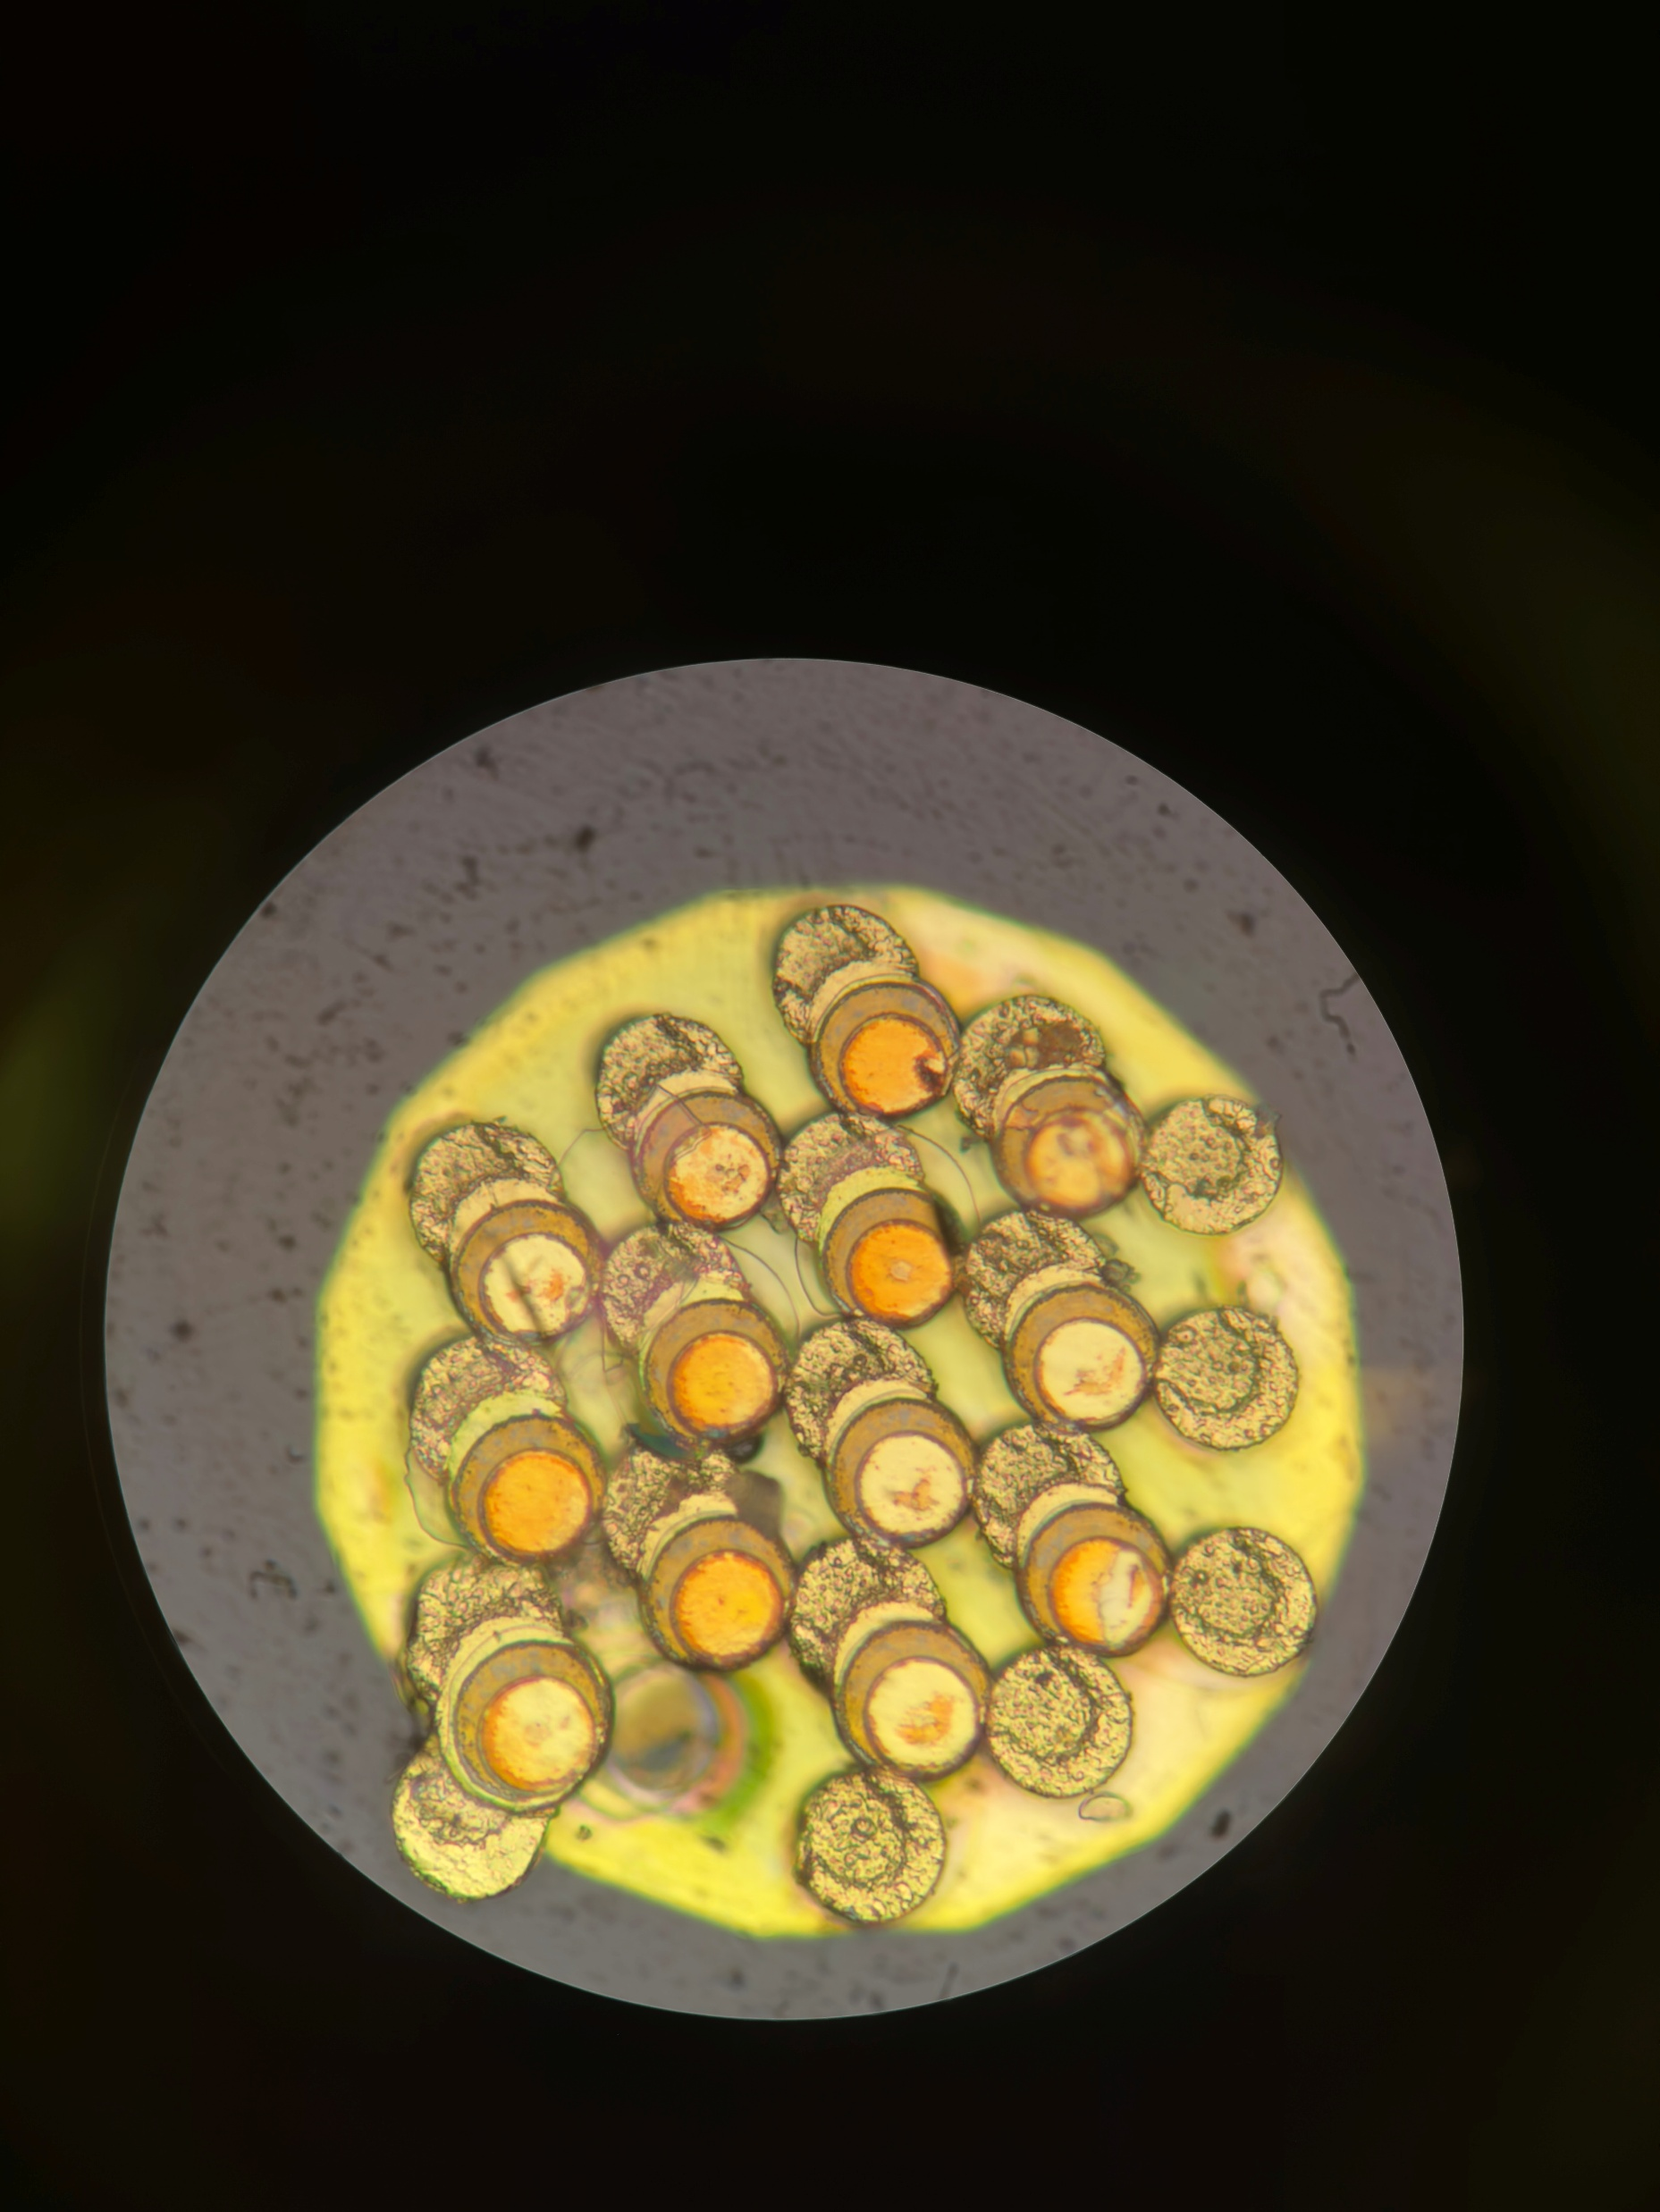
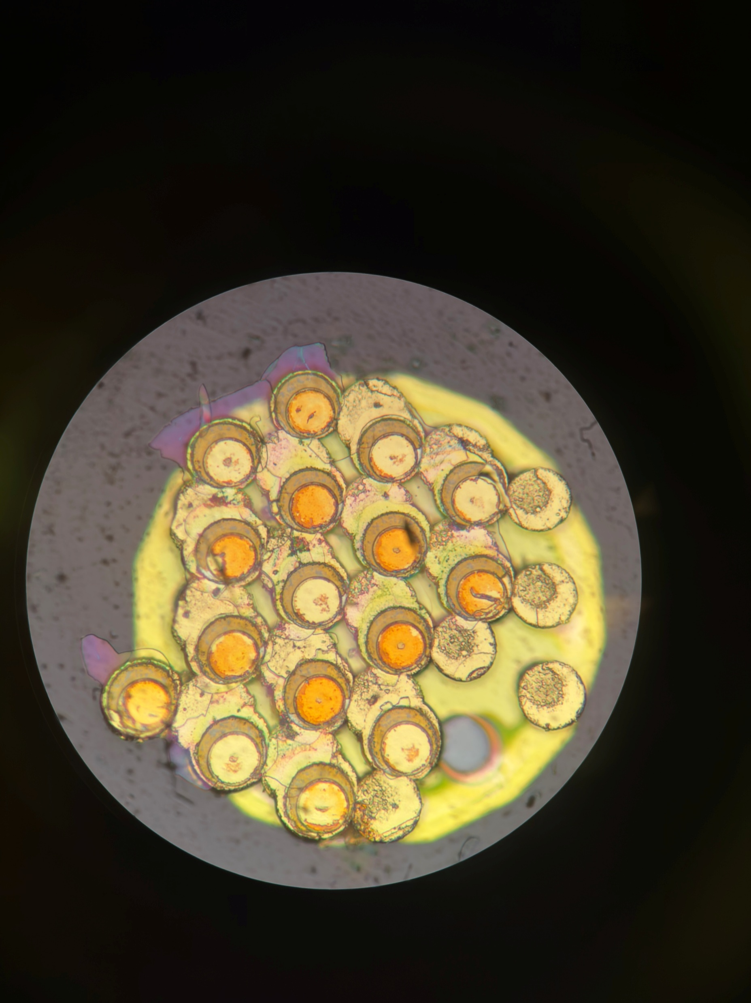
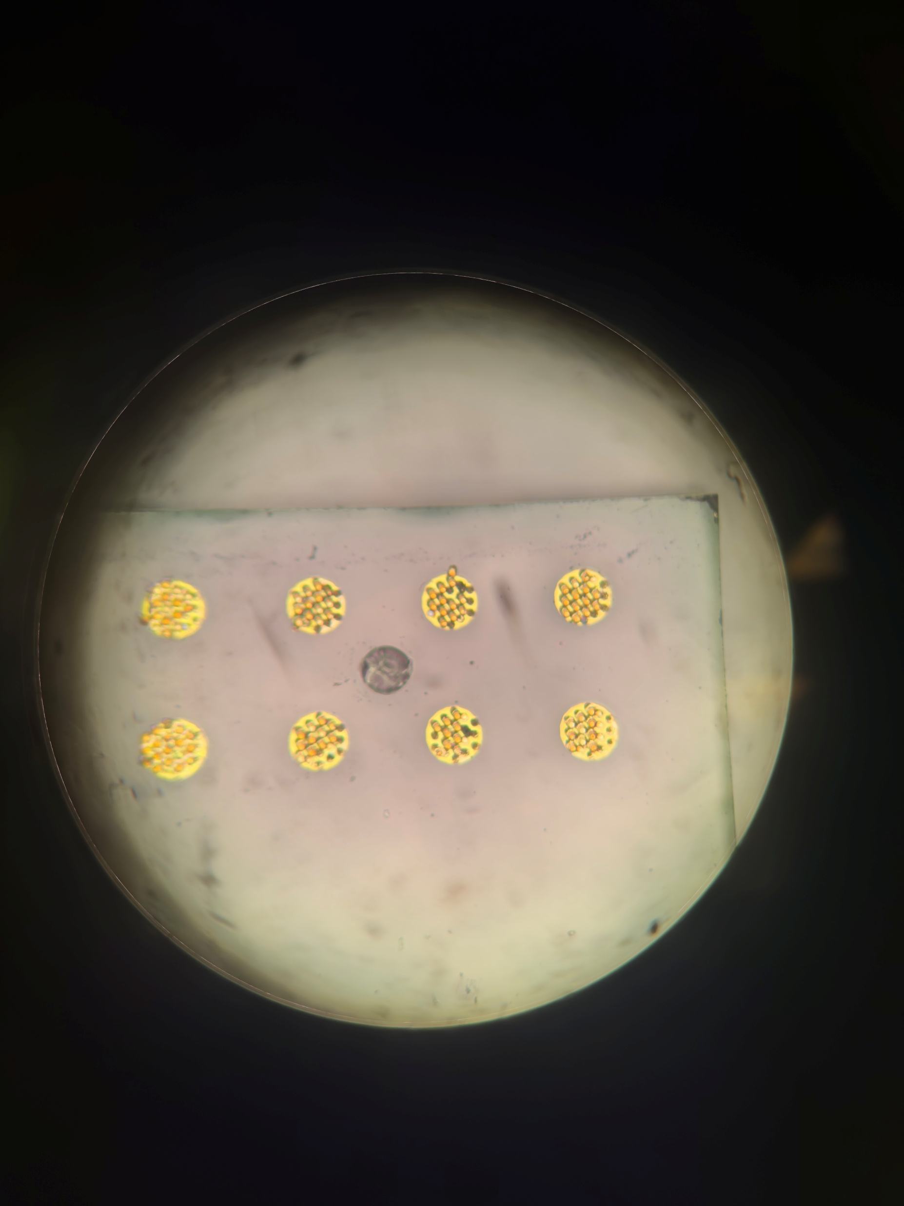
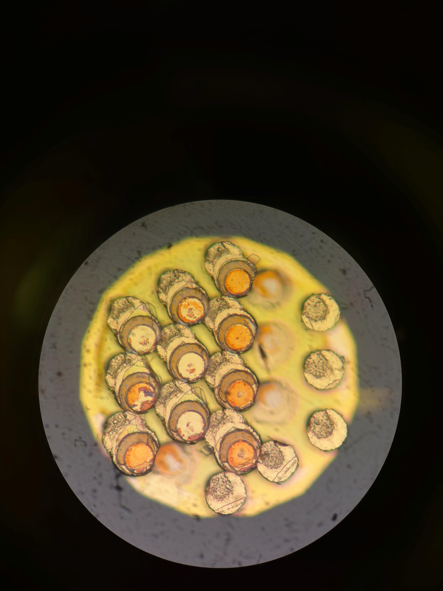
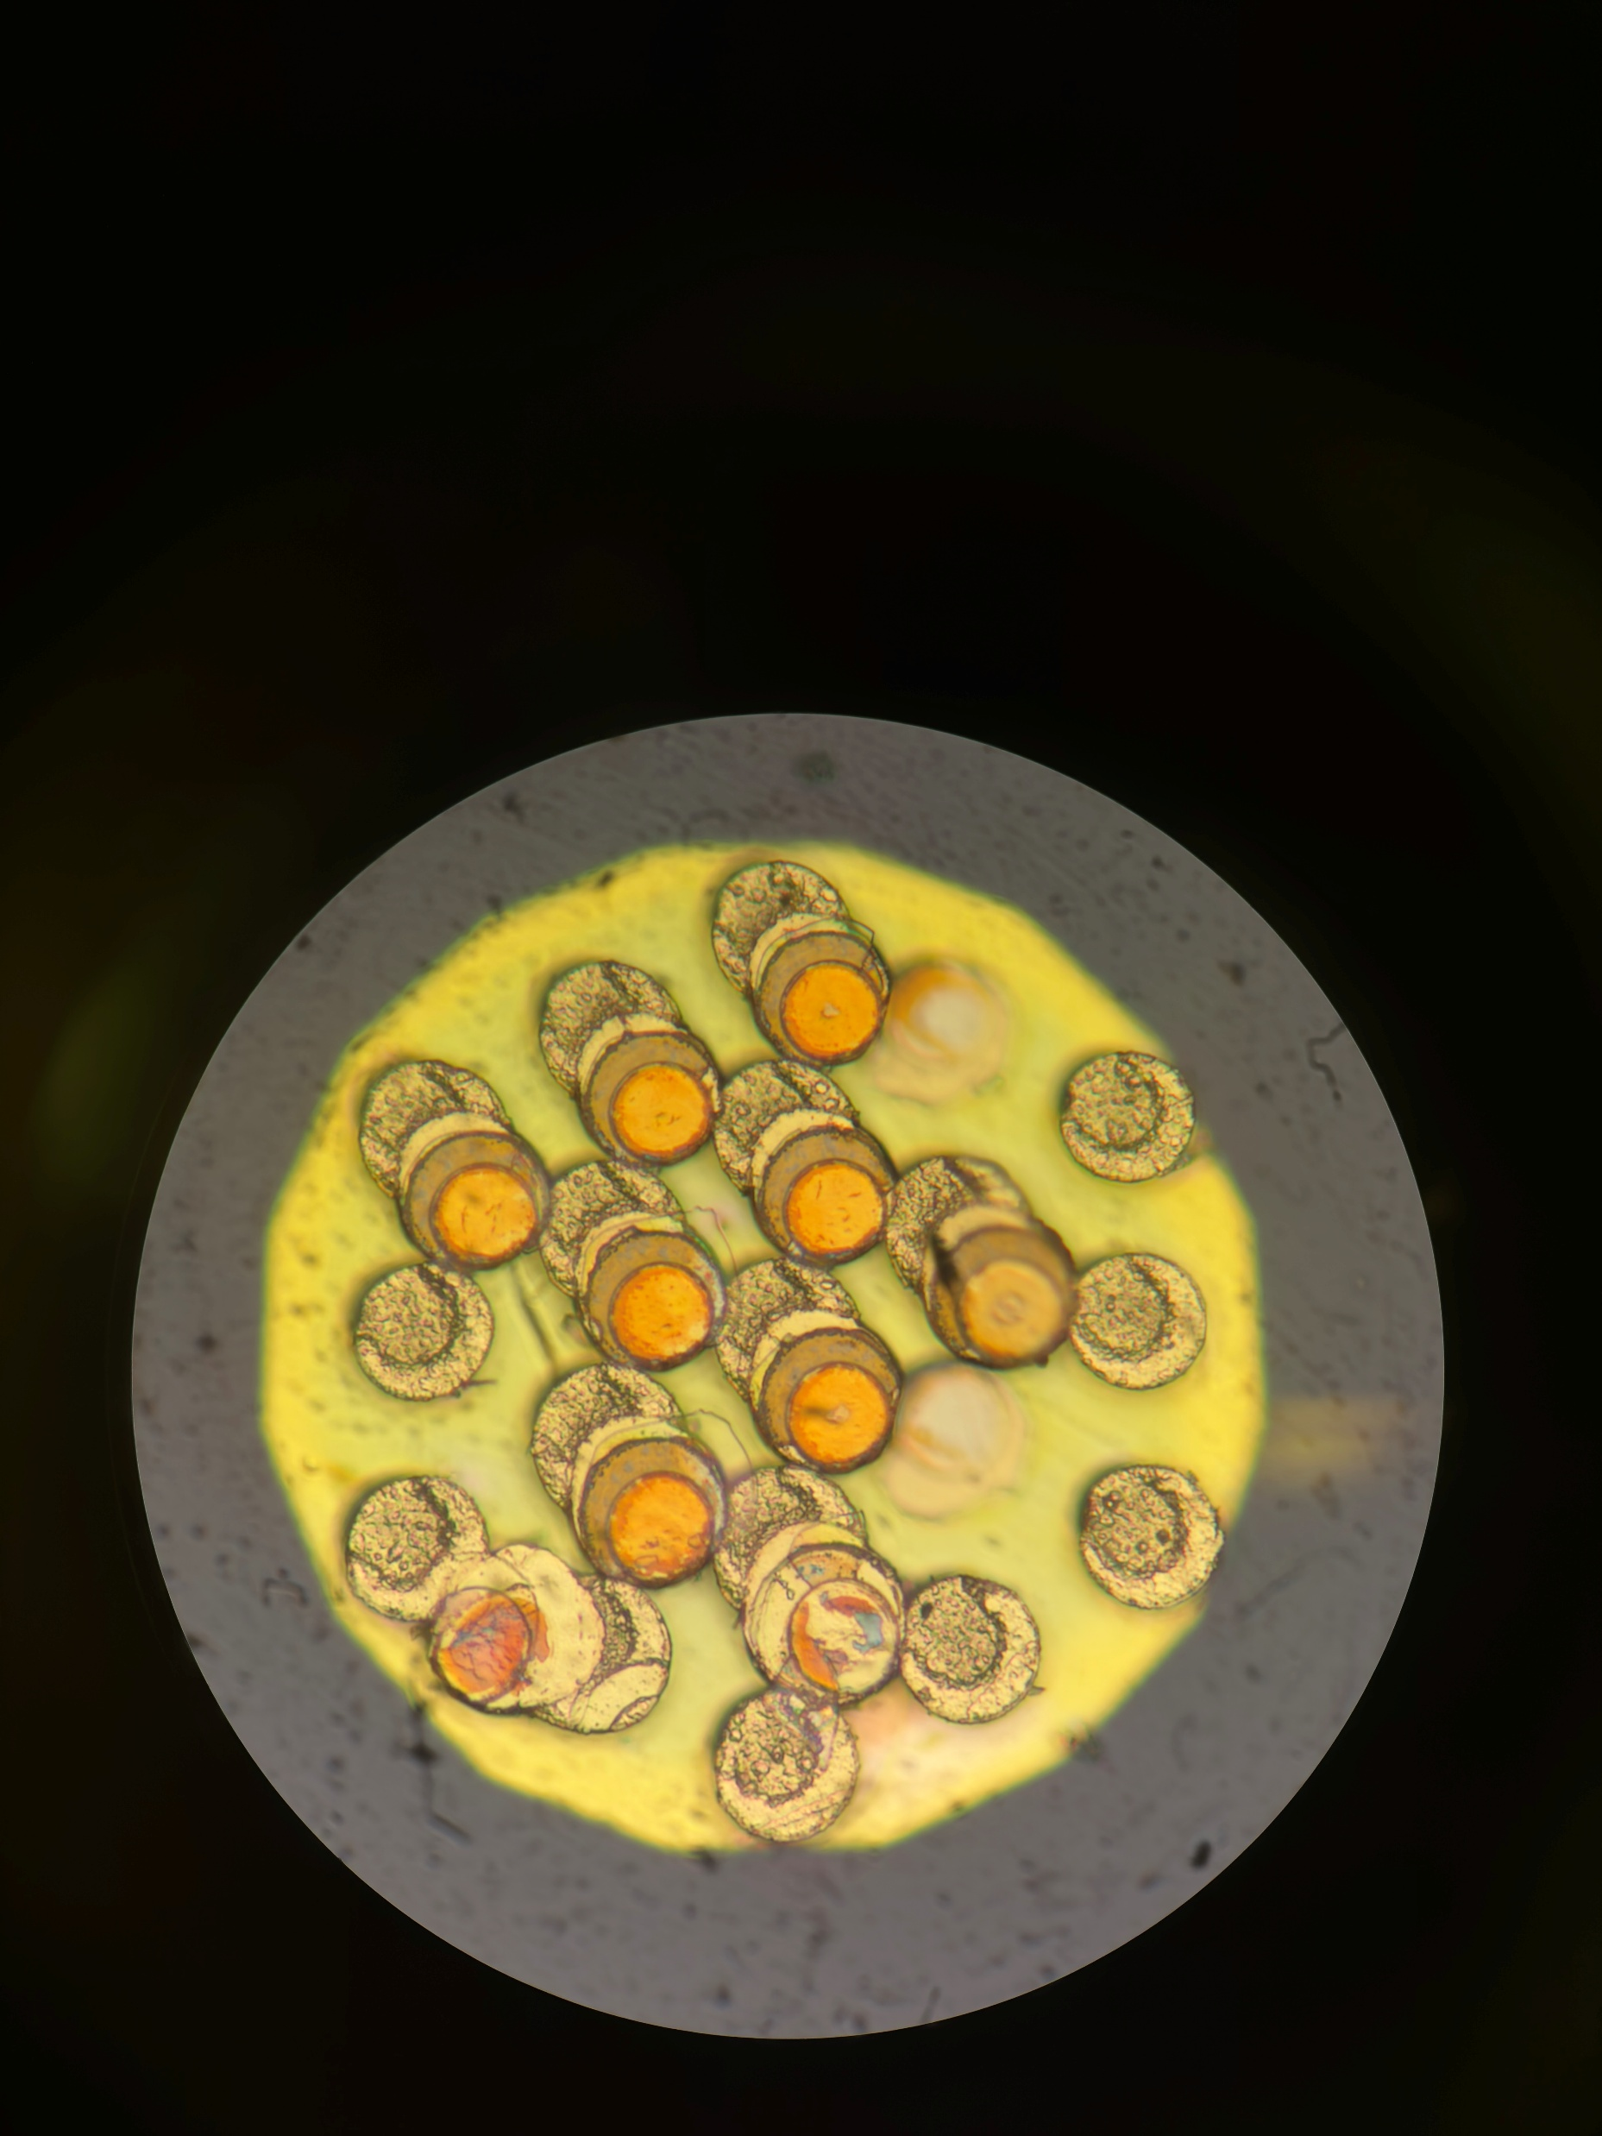
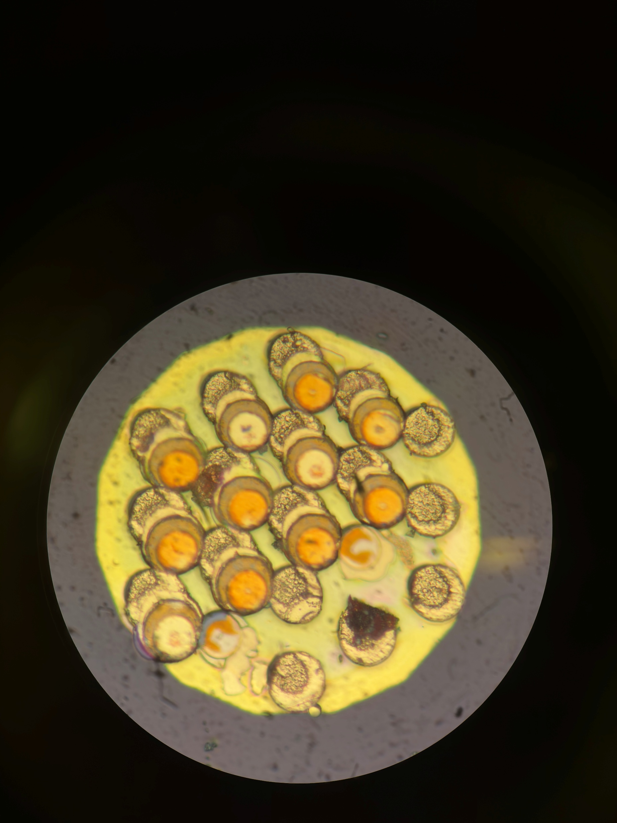
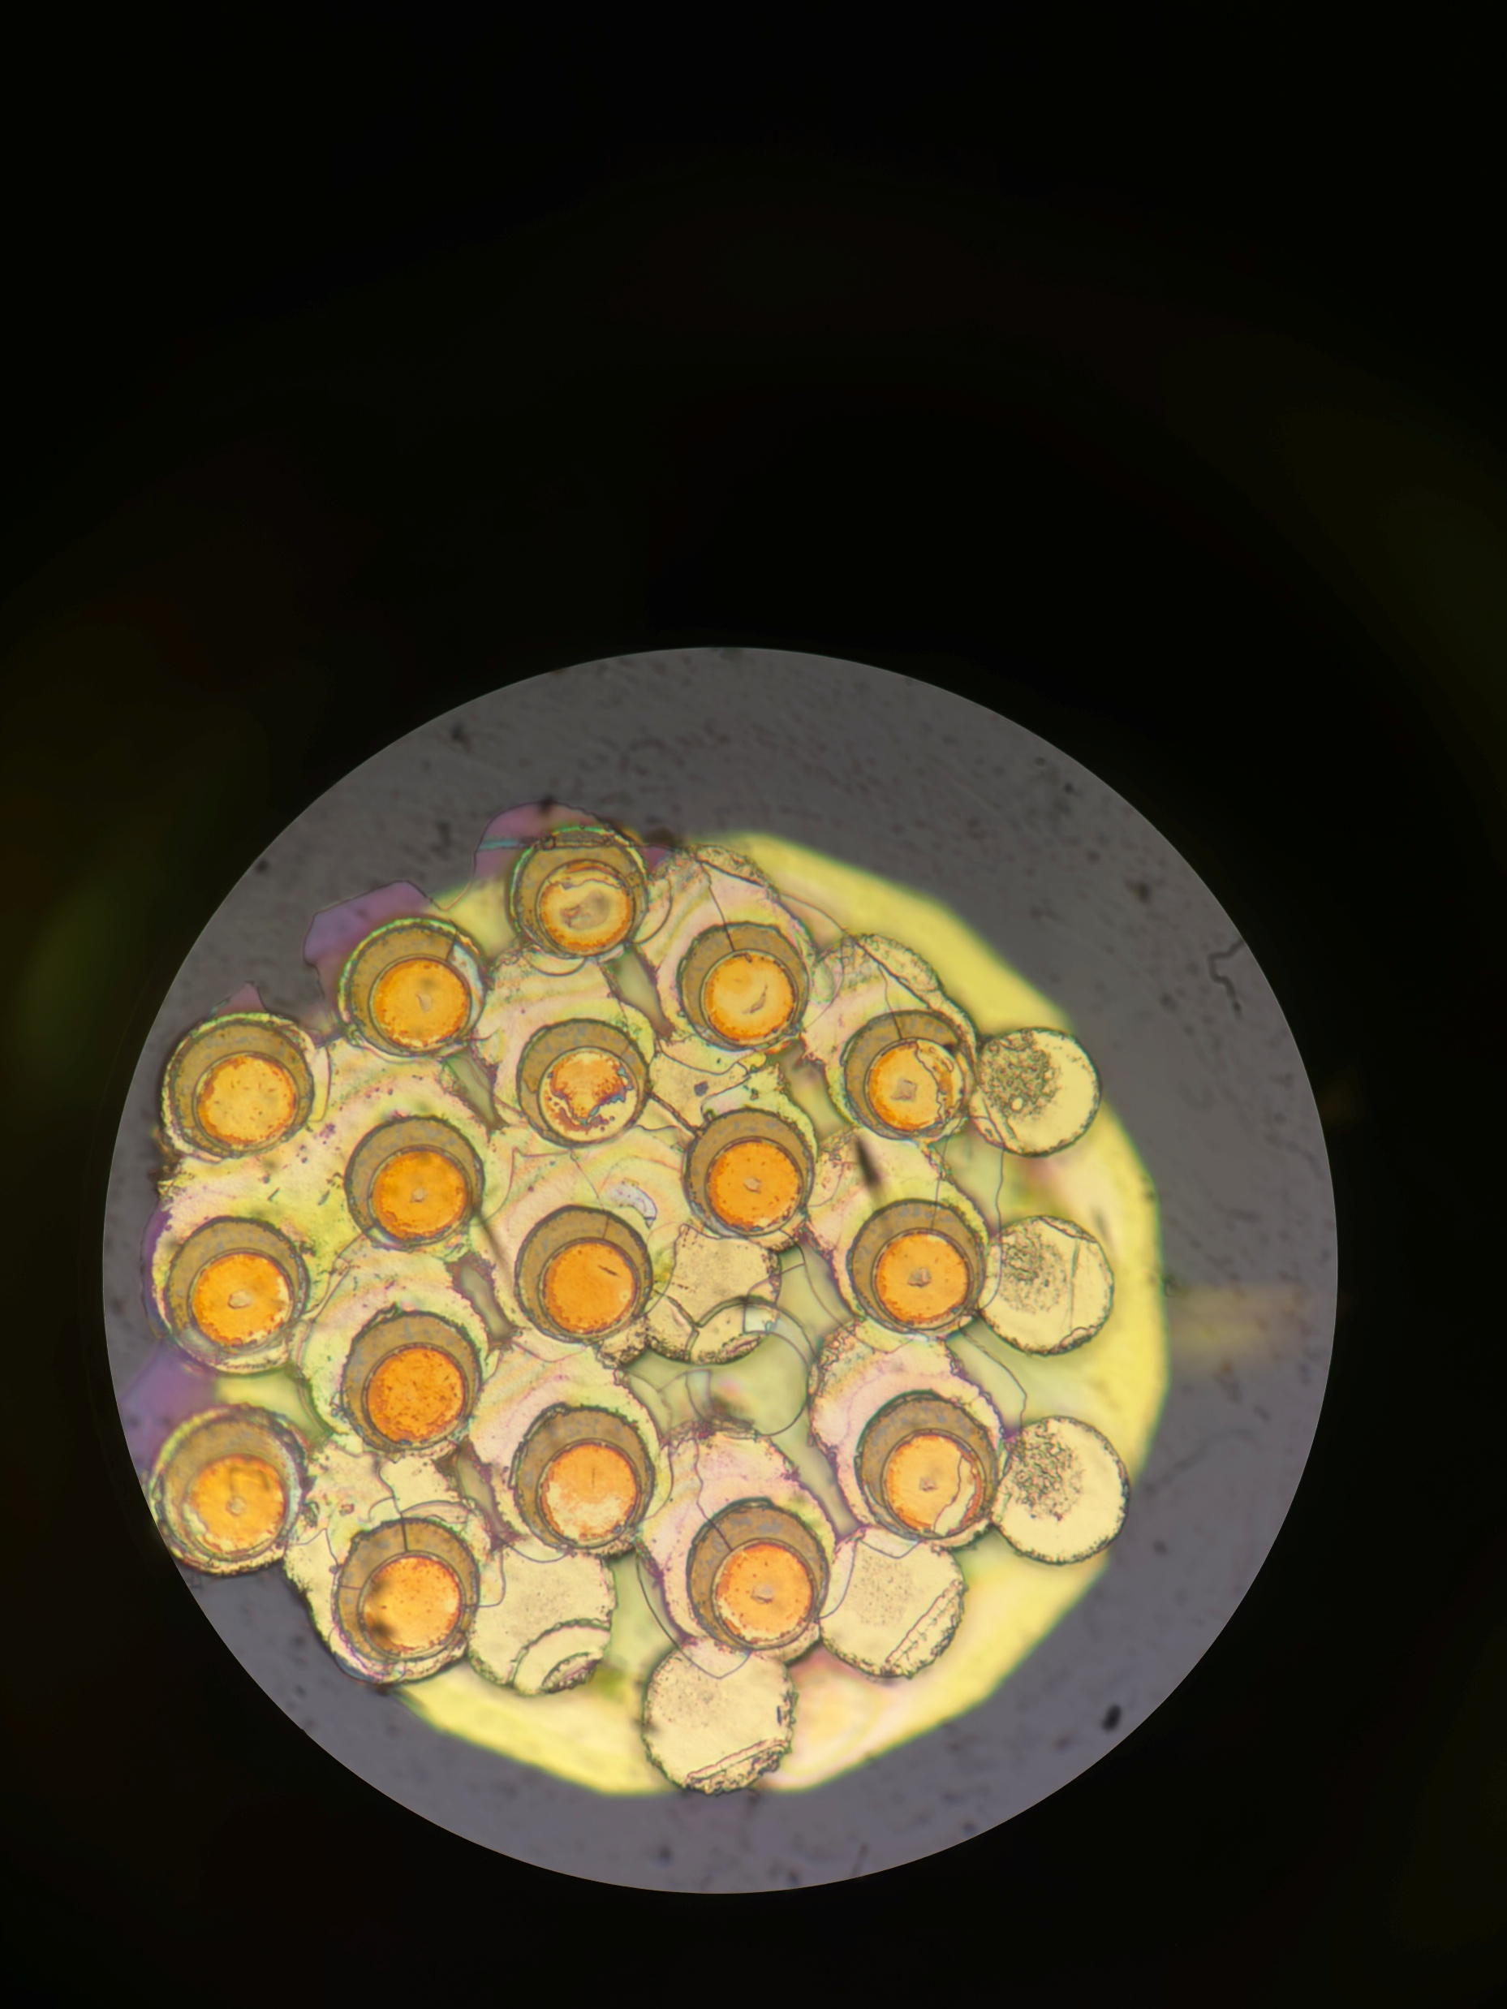
A25 Farside
Post Pull Test
Better alignment of pads

Slide 20

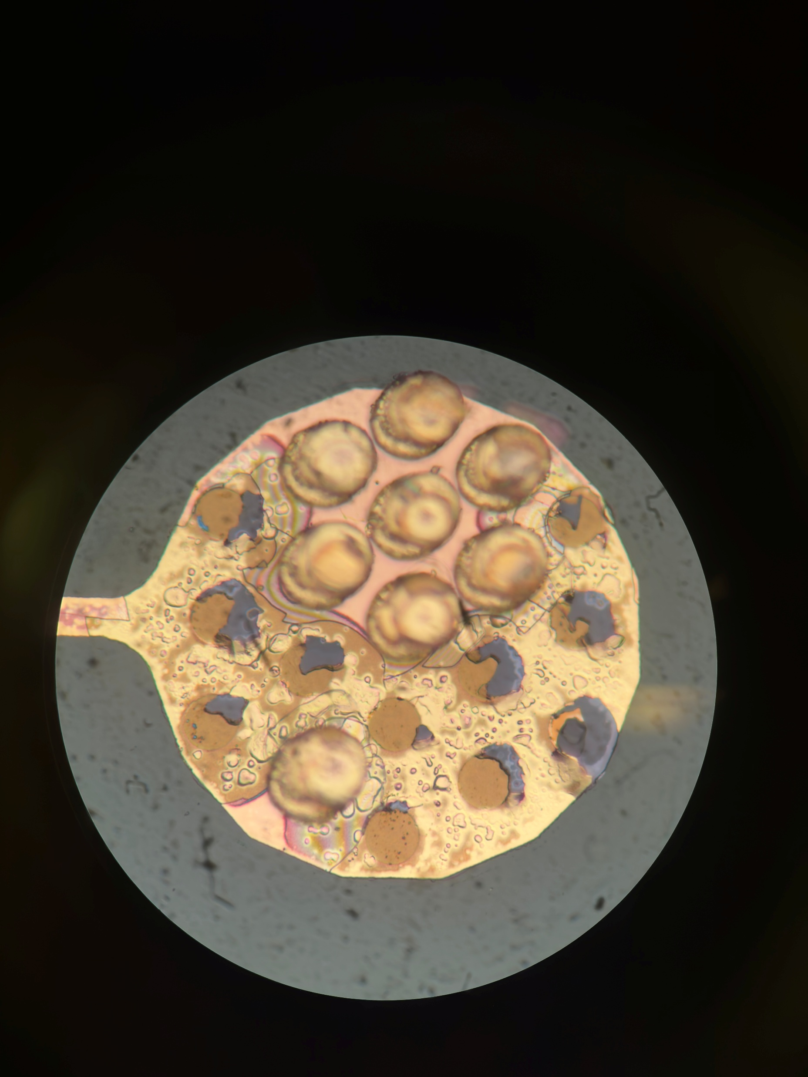
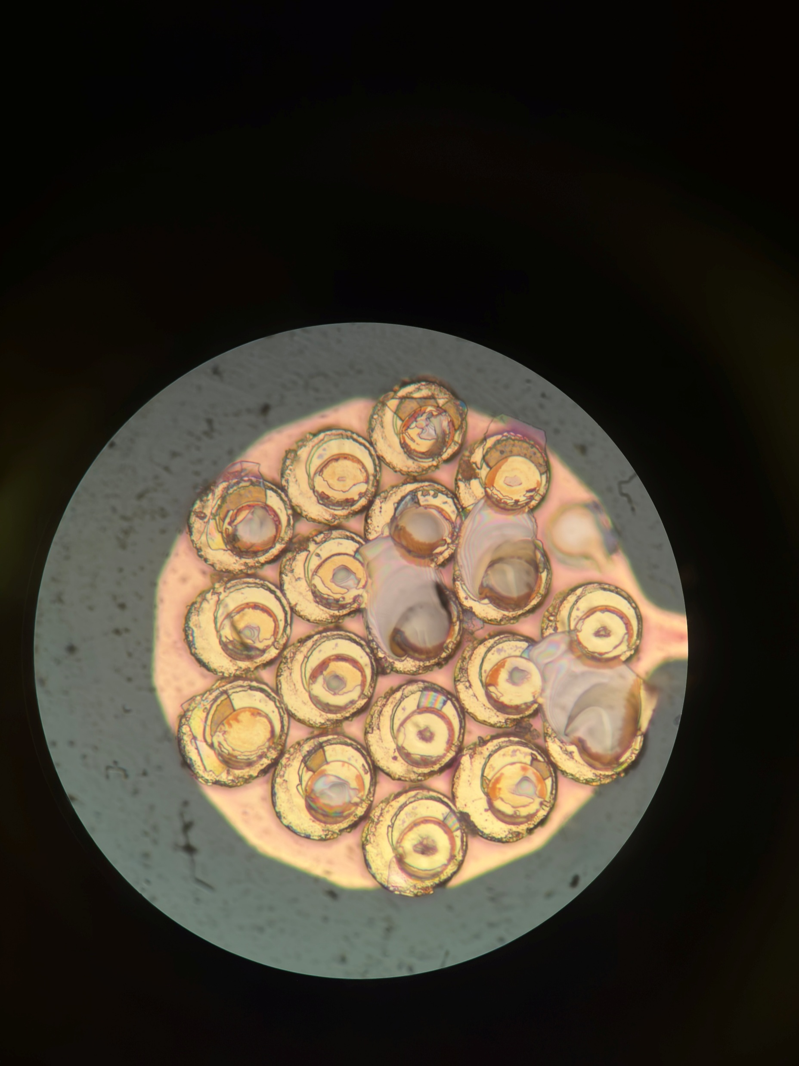
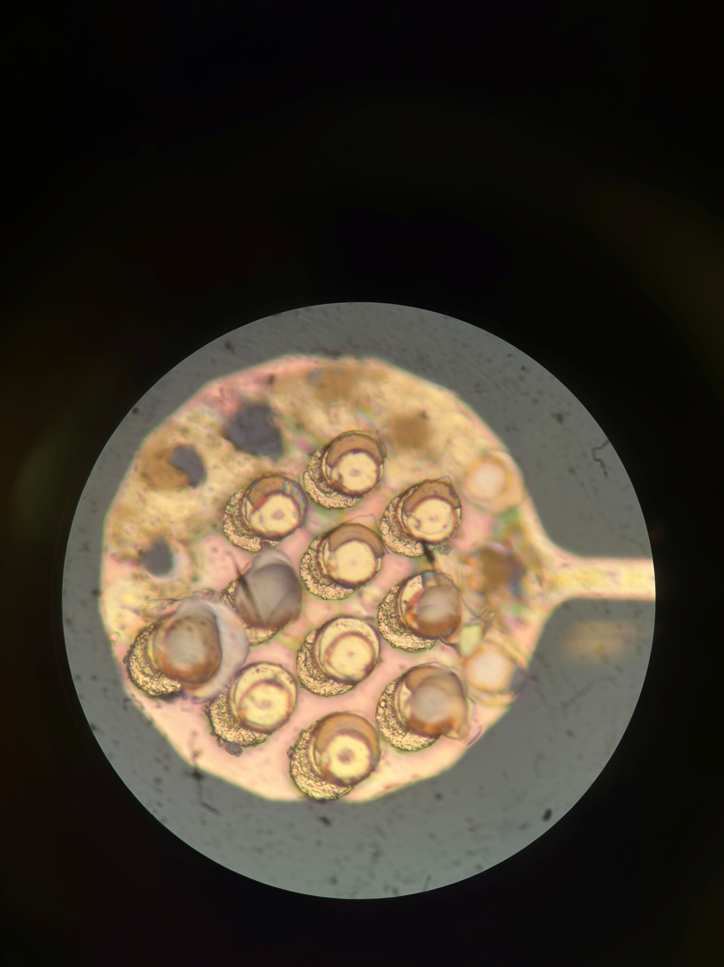
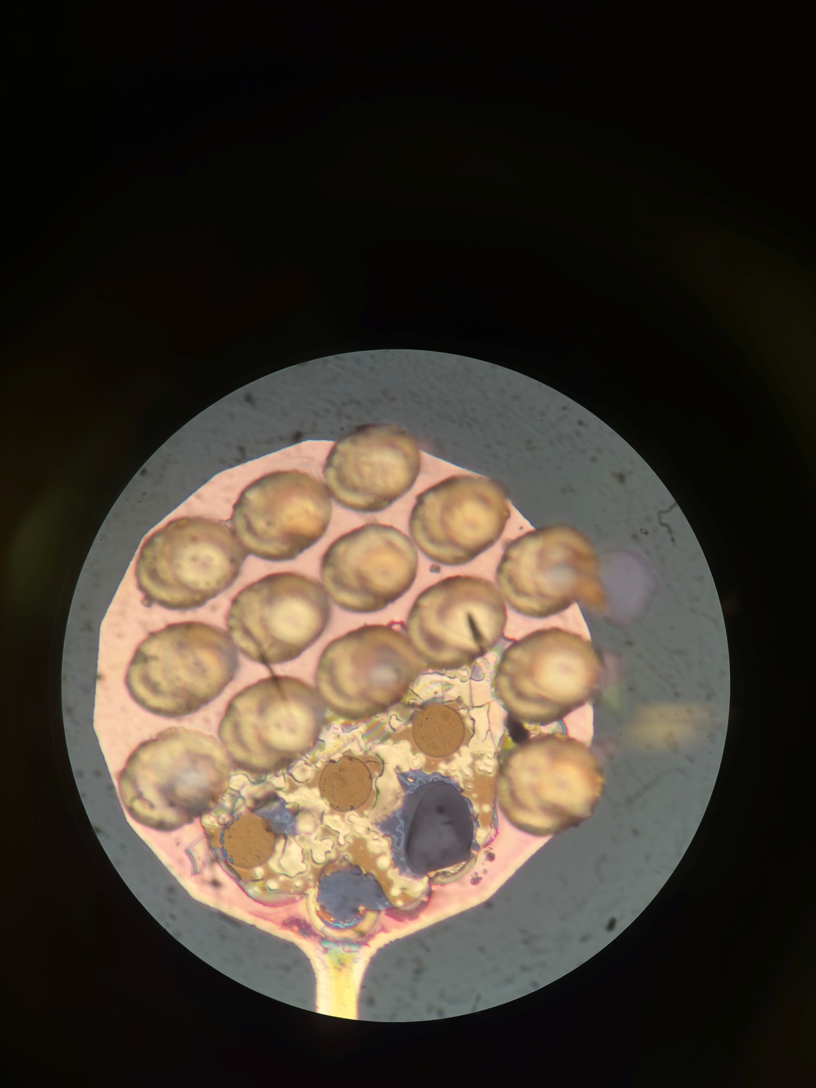
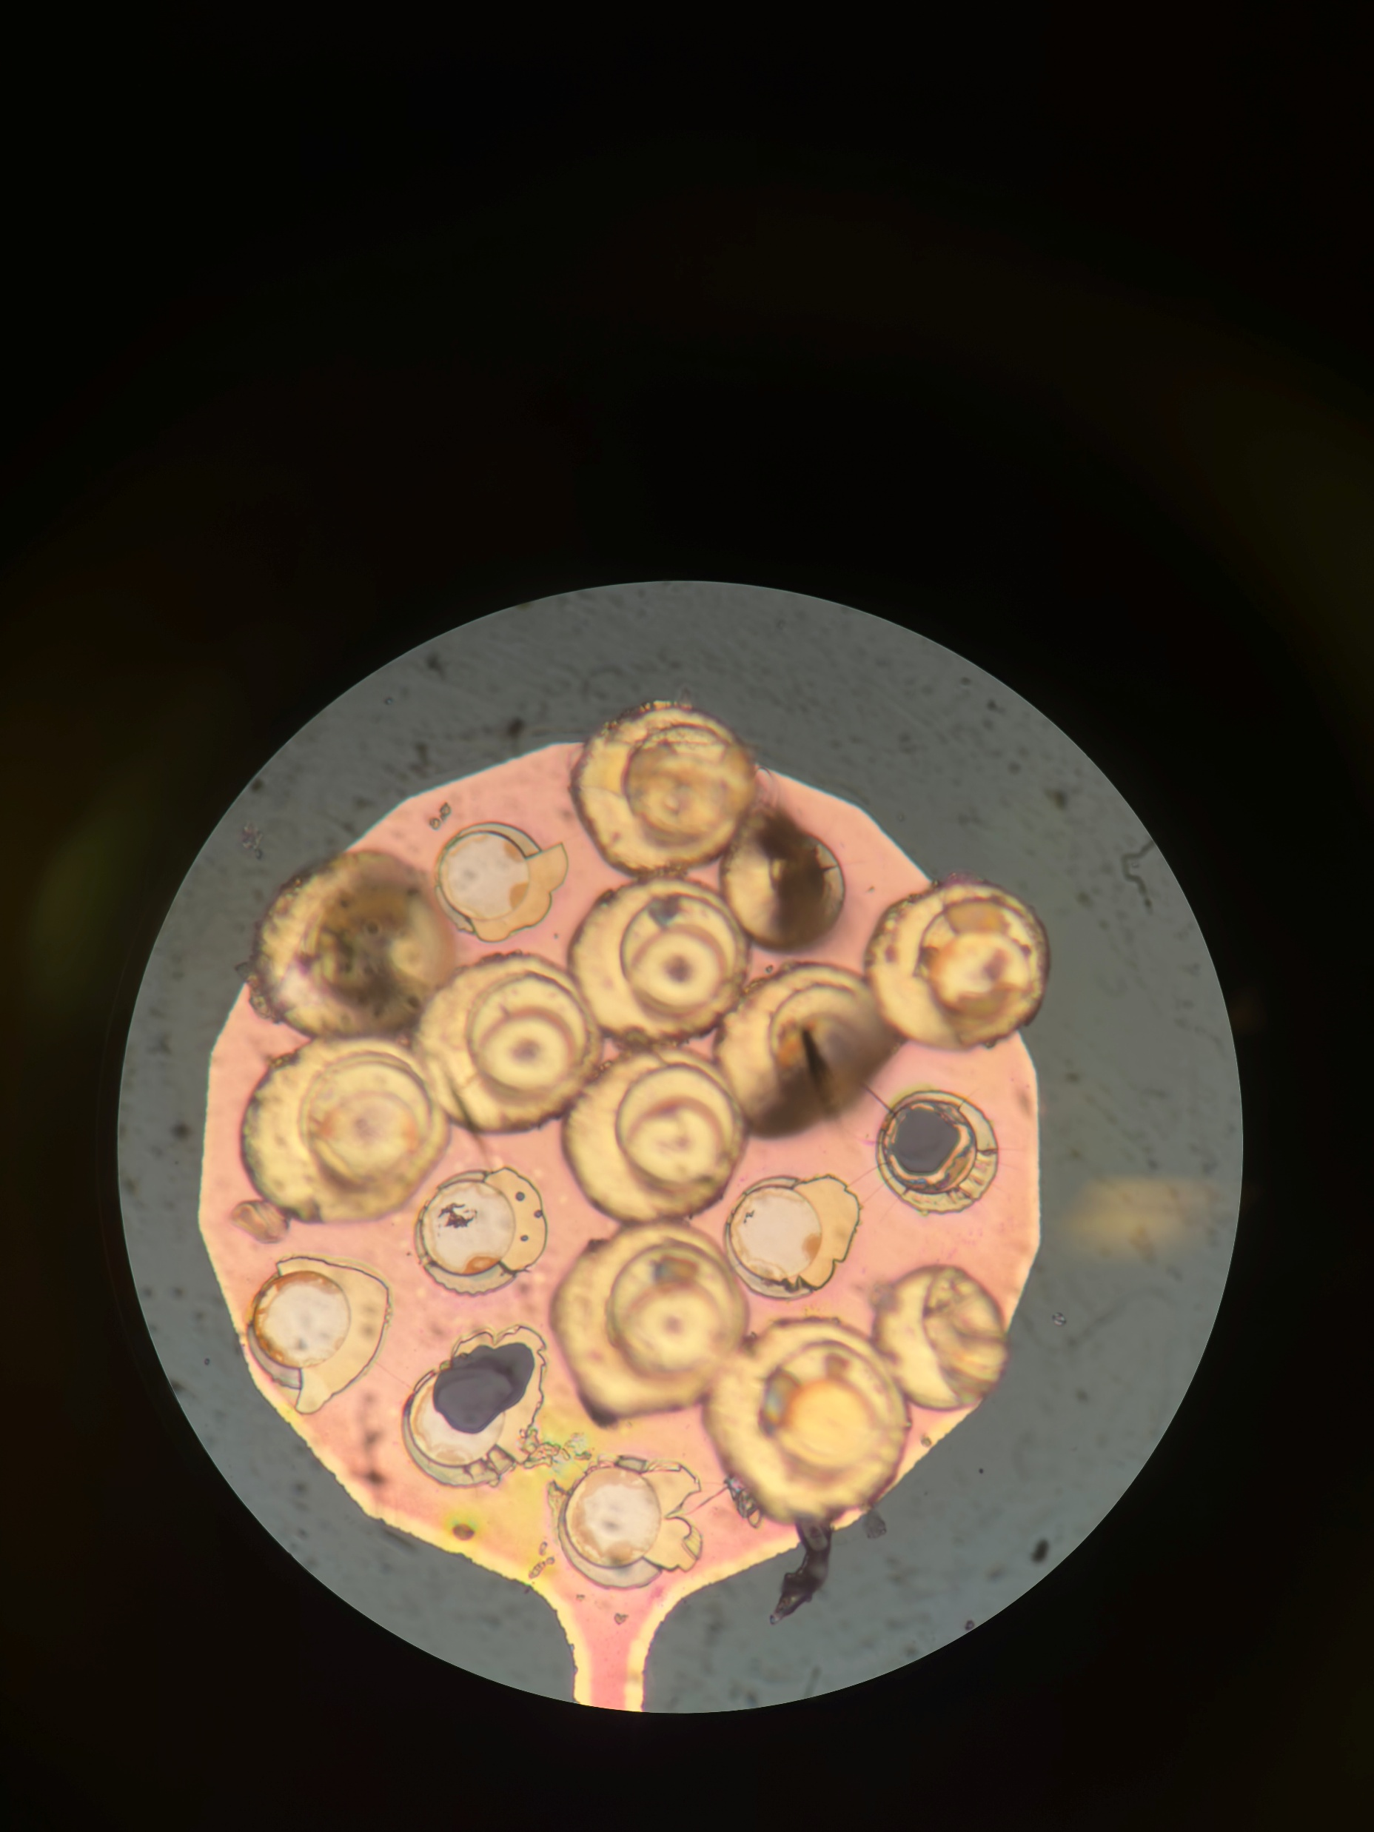
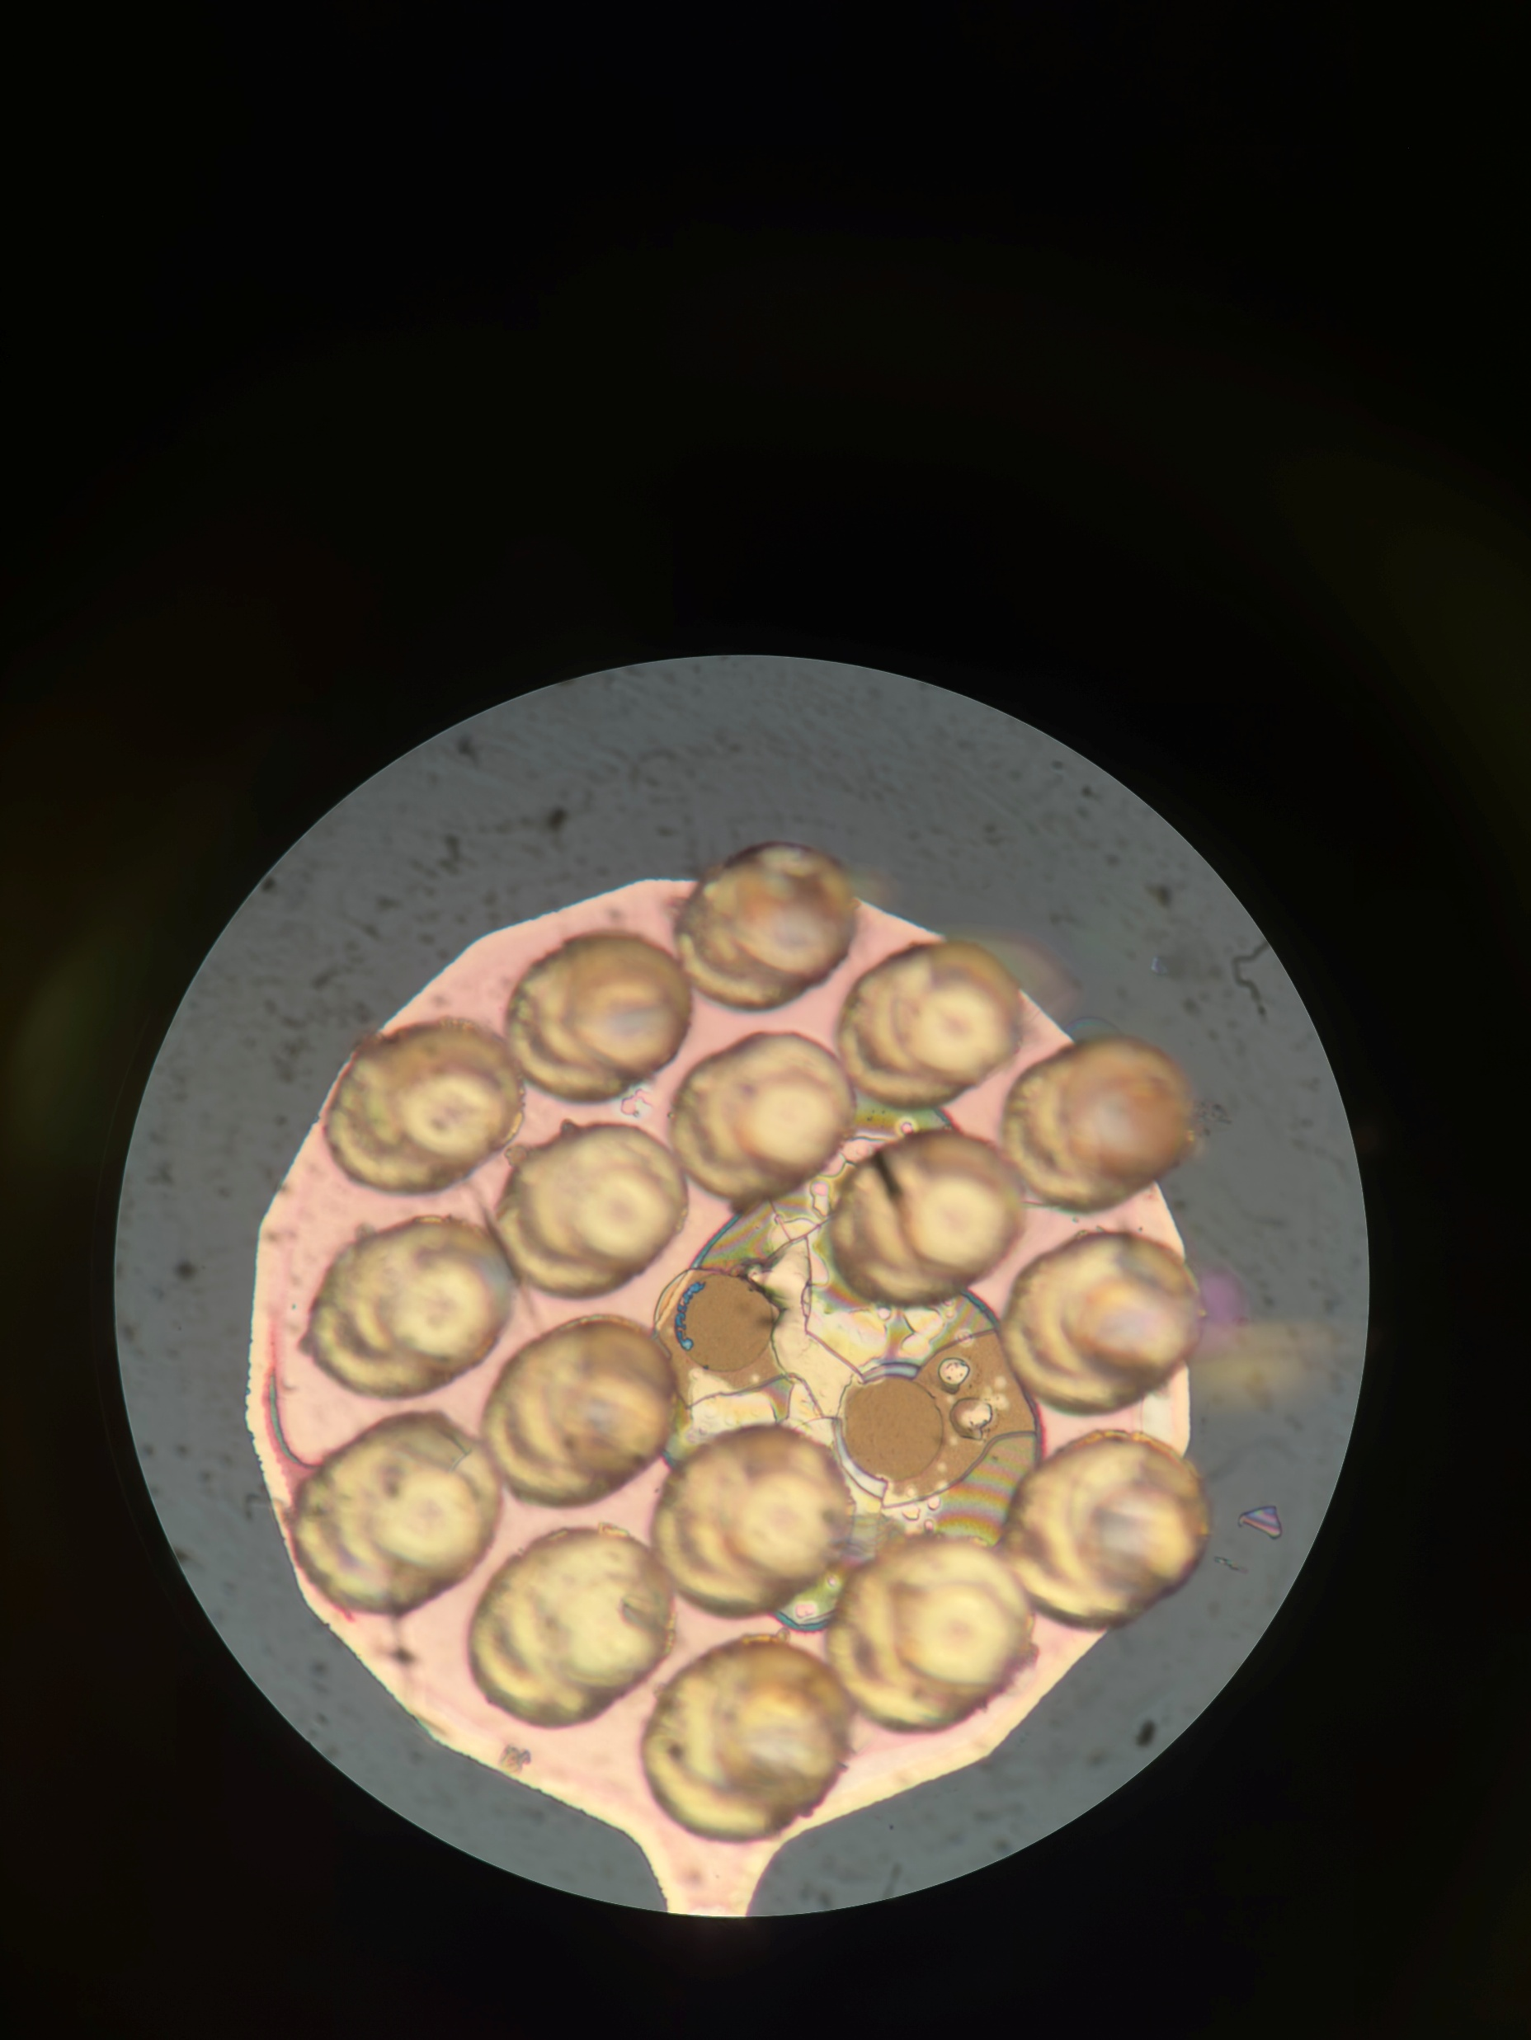
A25 Nearside
Post Pull Test
Better alignment of pads

Slide 21
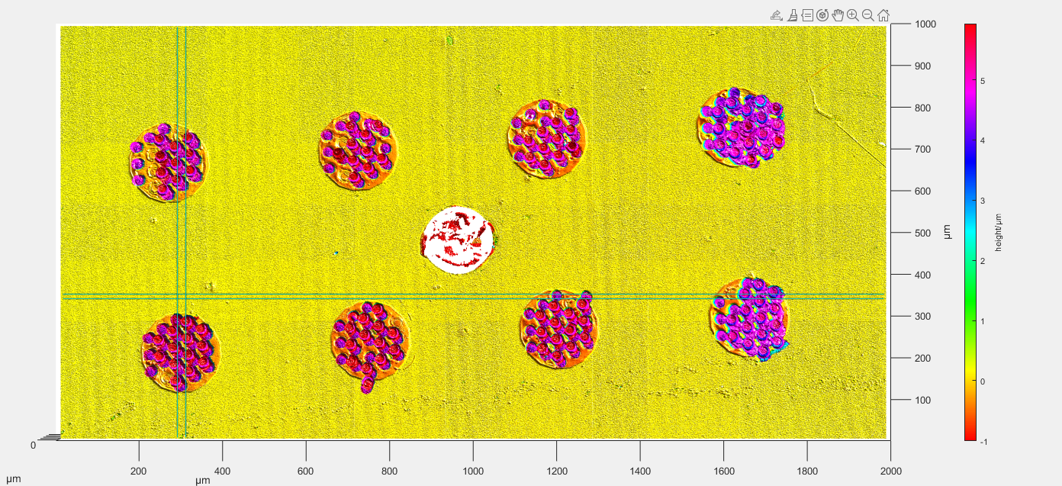

Slide 22
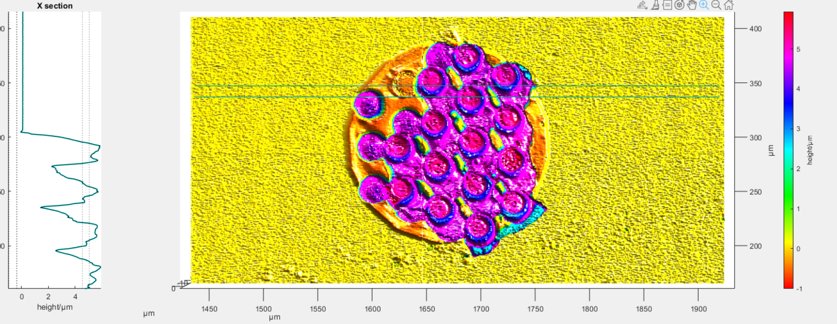
A25 Farside Pad 8
Post Pull Test

Slide 24
Summary
Annealing has changed the failure point
No longer seeing failure in titanium, but earlier up
No 1um ‘nubs’ on top of PECVD
Bond is also weaker than before
Still see some signs of bonds failing in the glass layer.

